Slide 1
s-SNOM Measurements
April, 2018
Leaky wave antenna, design #4 (more asymmetric)
Under different polarizations (LP & CP)
k vector parallel to TL

Slide 2
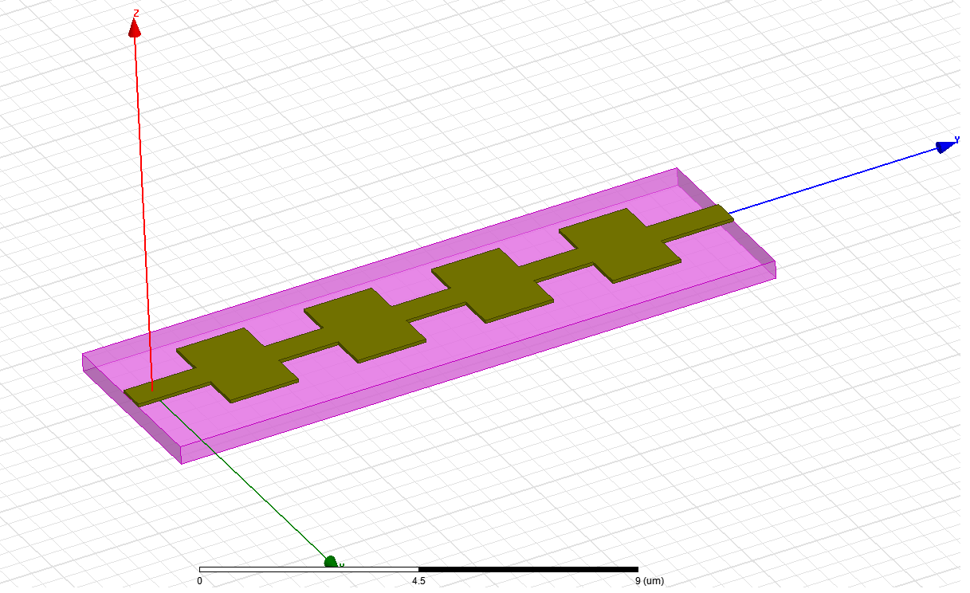
Illumination conditions
Incident angle θ = 60º
Light: linear polarization
Incidence: p-polarization (k and E vectors are in the YZ plane)
Structure E4
Z
E_{i}
Y
θ
k-vector
X

Slide 3
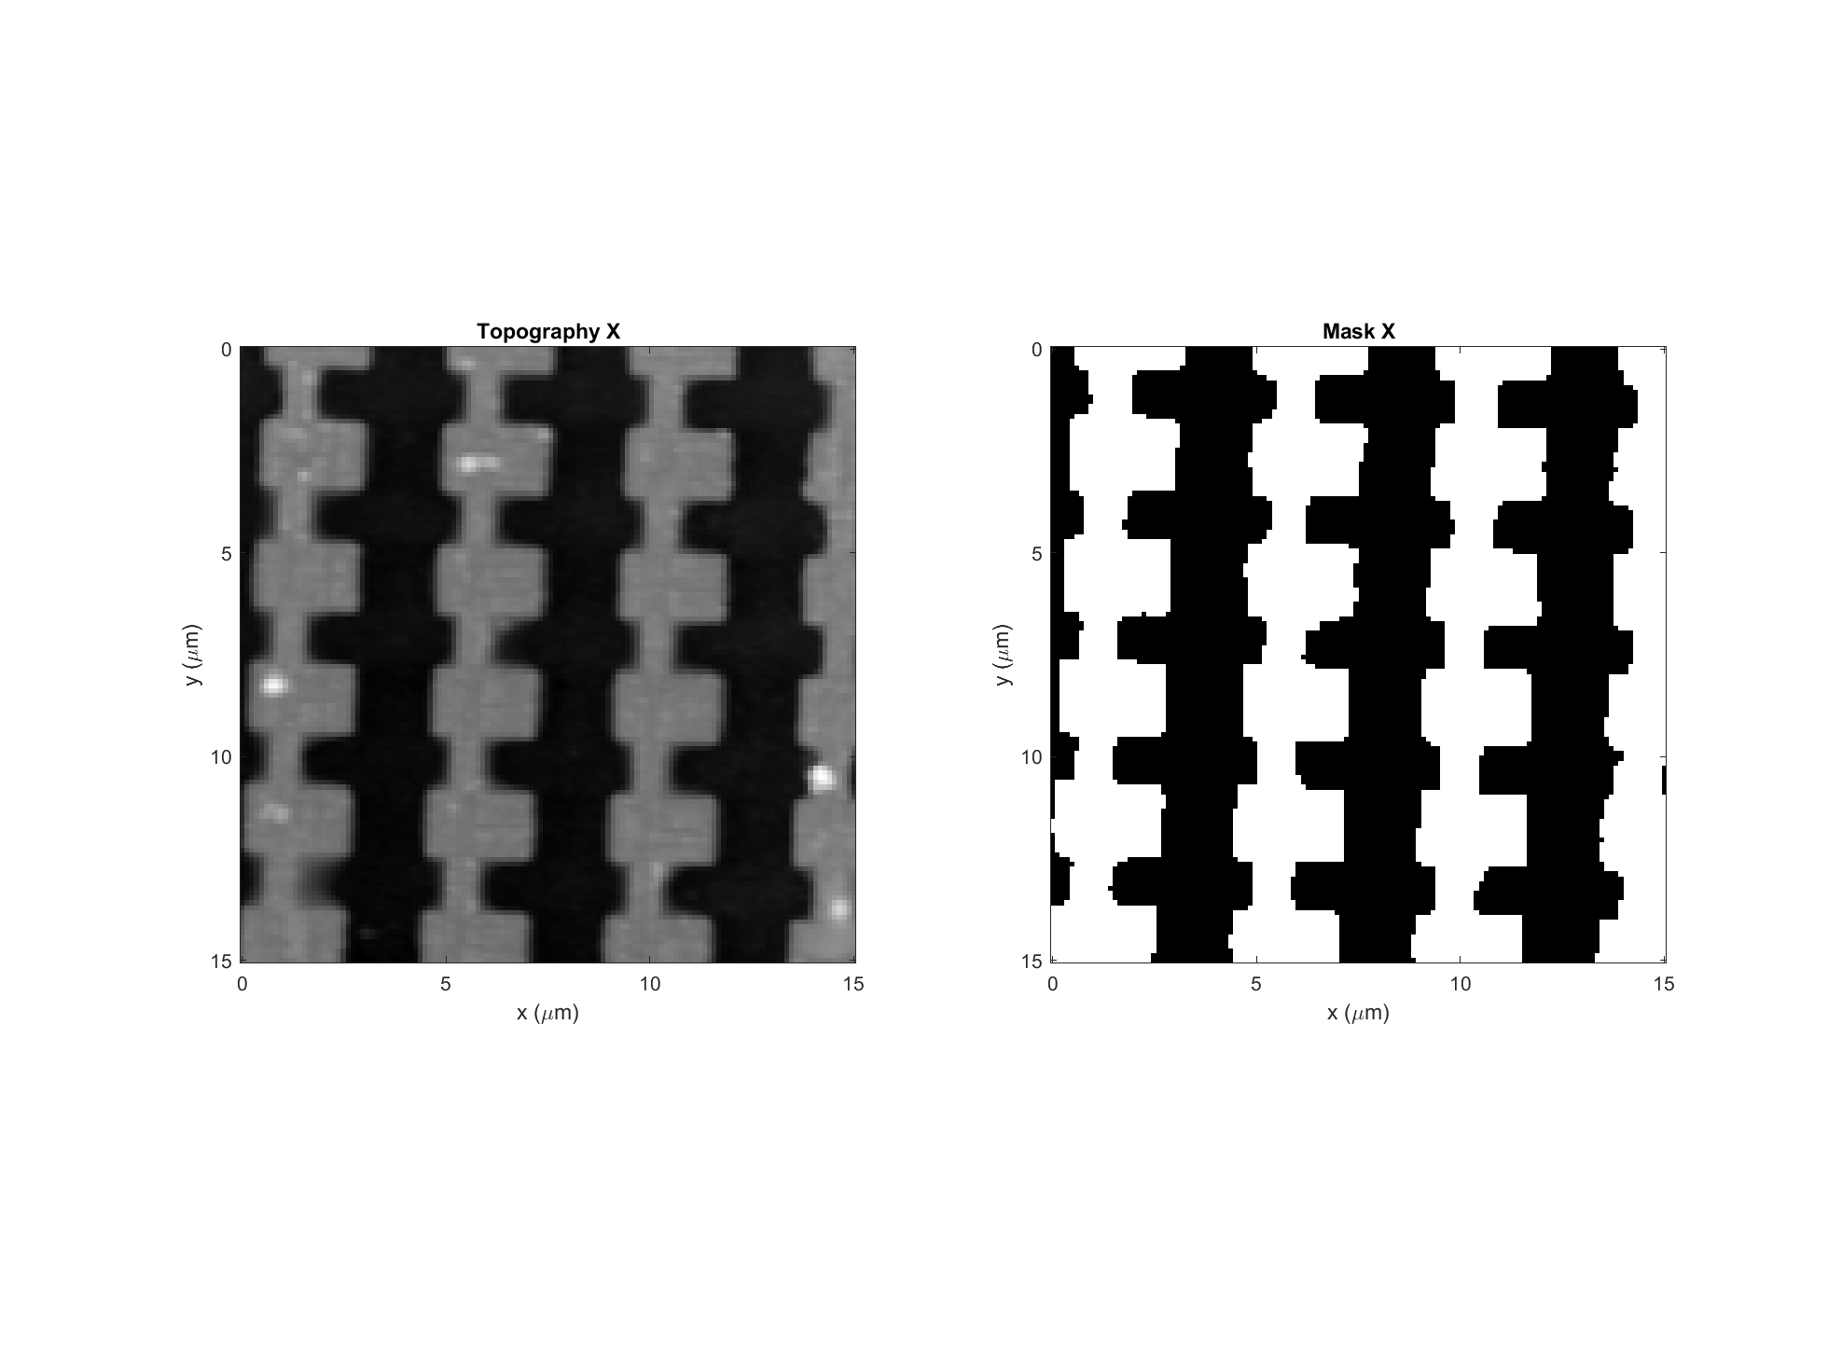
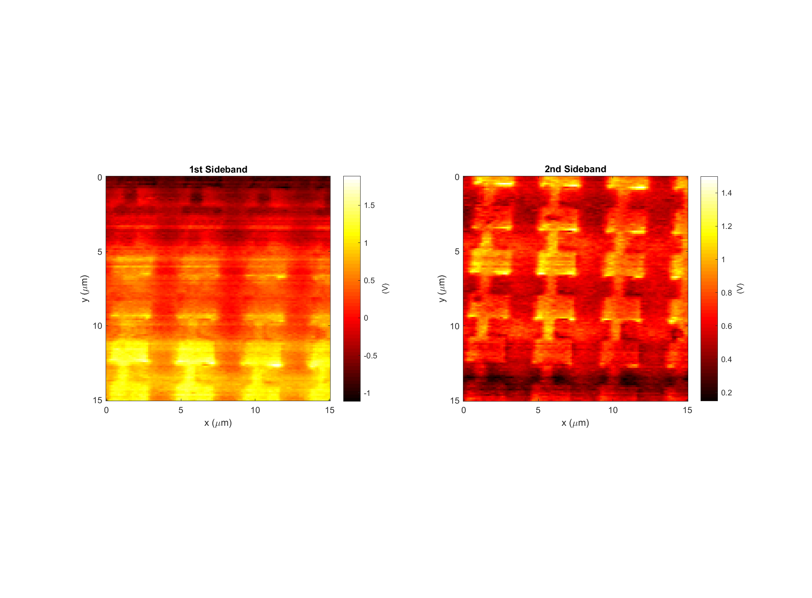
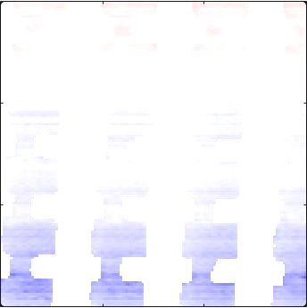
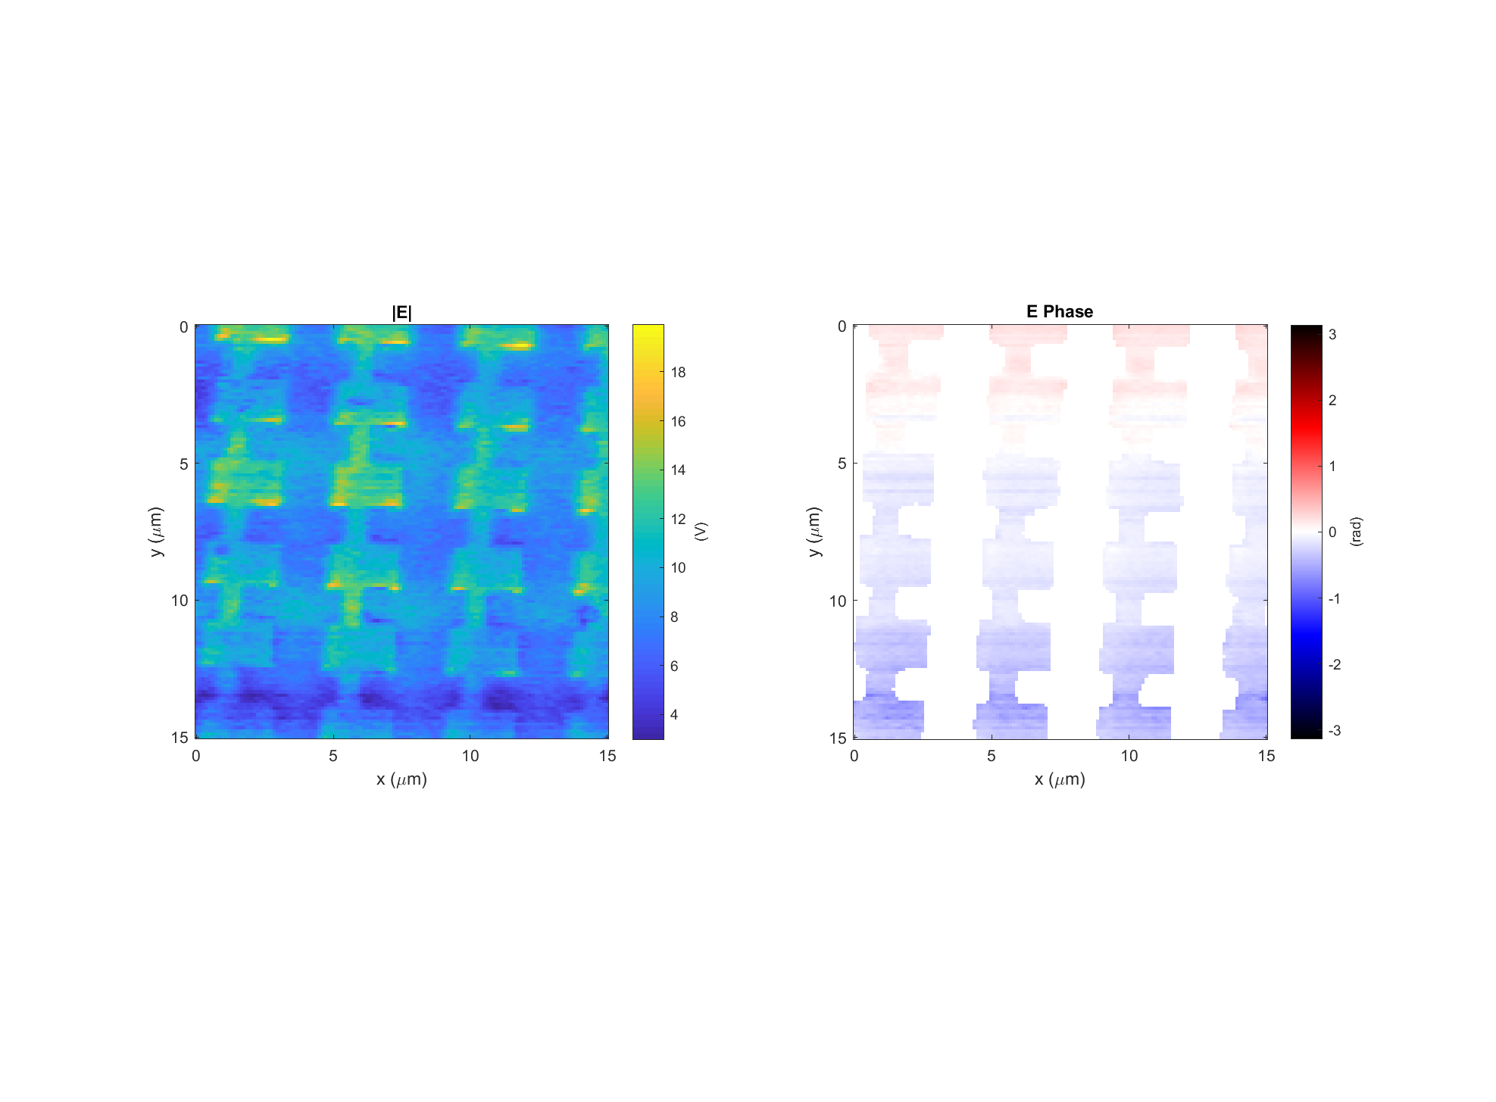
Leaky wave antenna, design #4 (E4)
Data: 2018-04-07_leaky_E_4_V_PH_X_2
Light incident from below
k

Slide 4

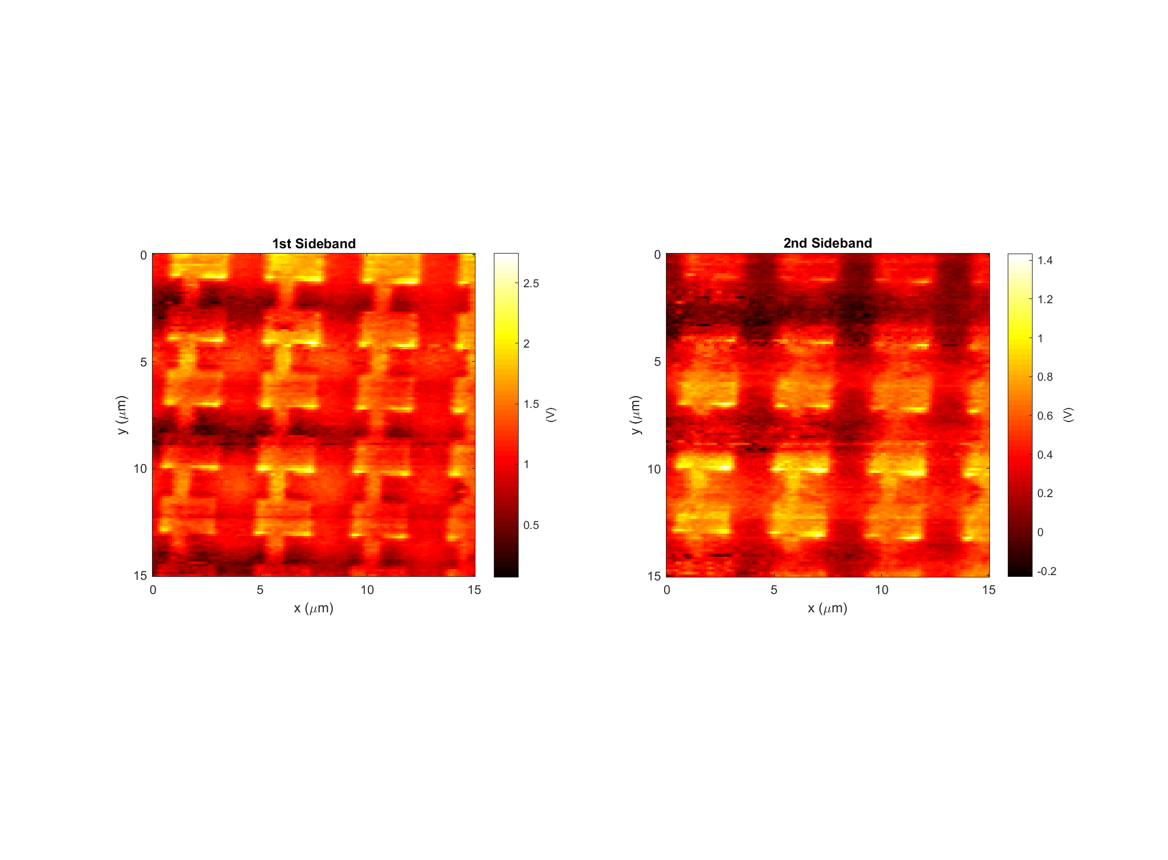
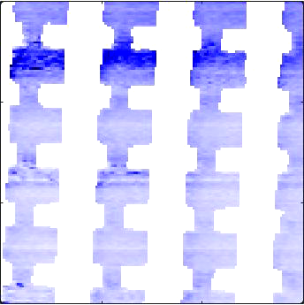
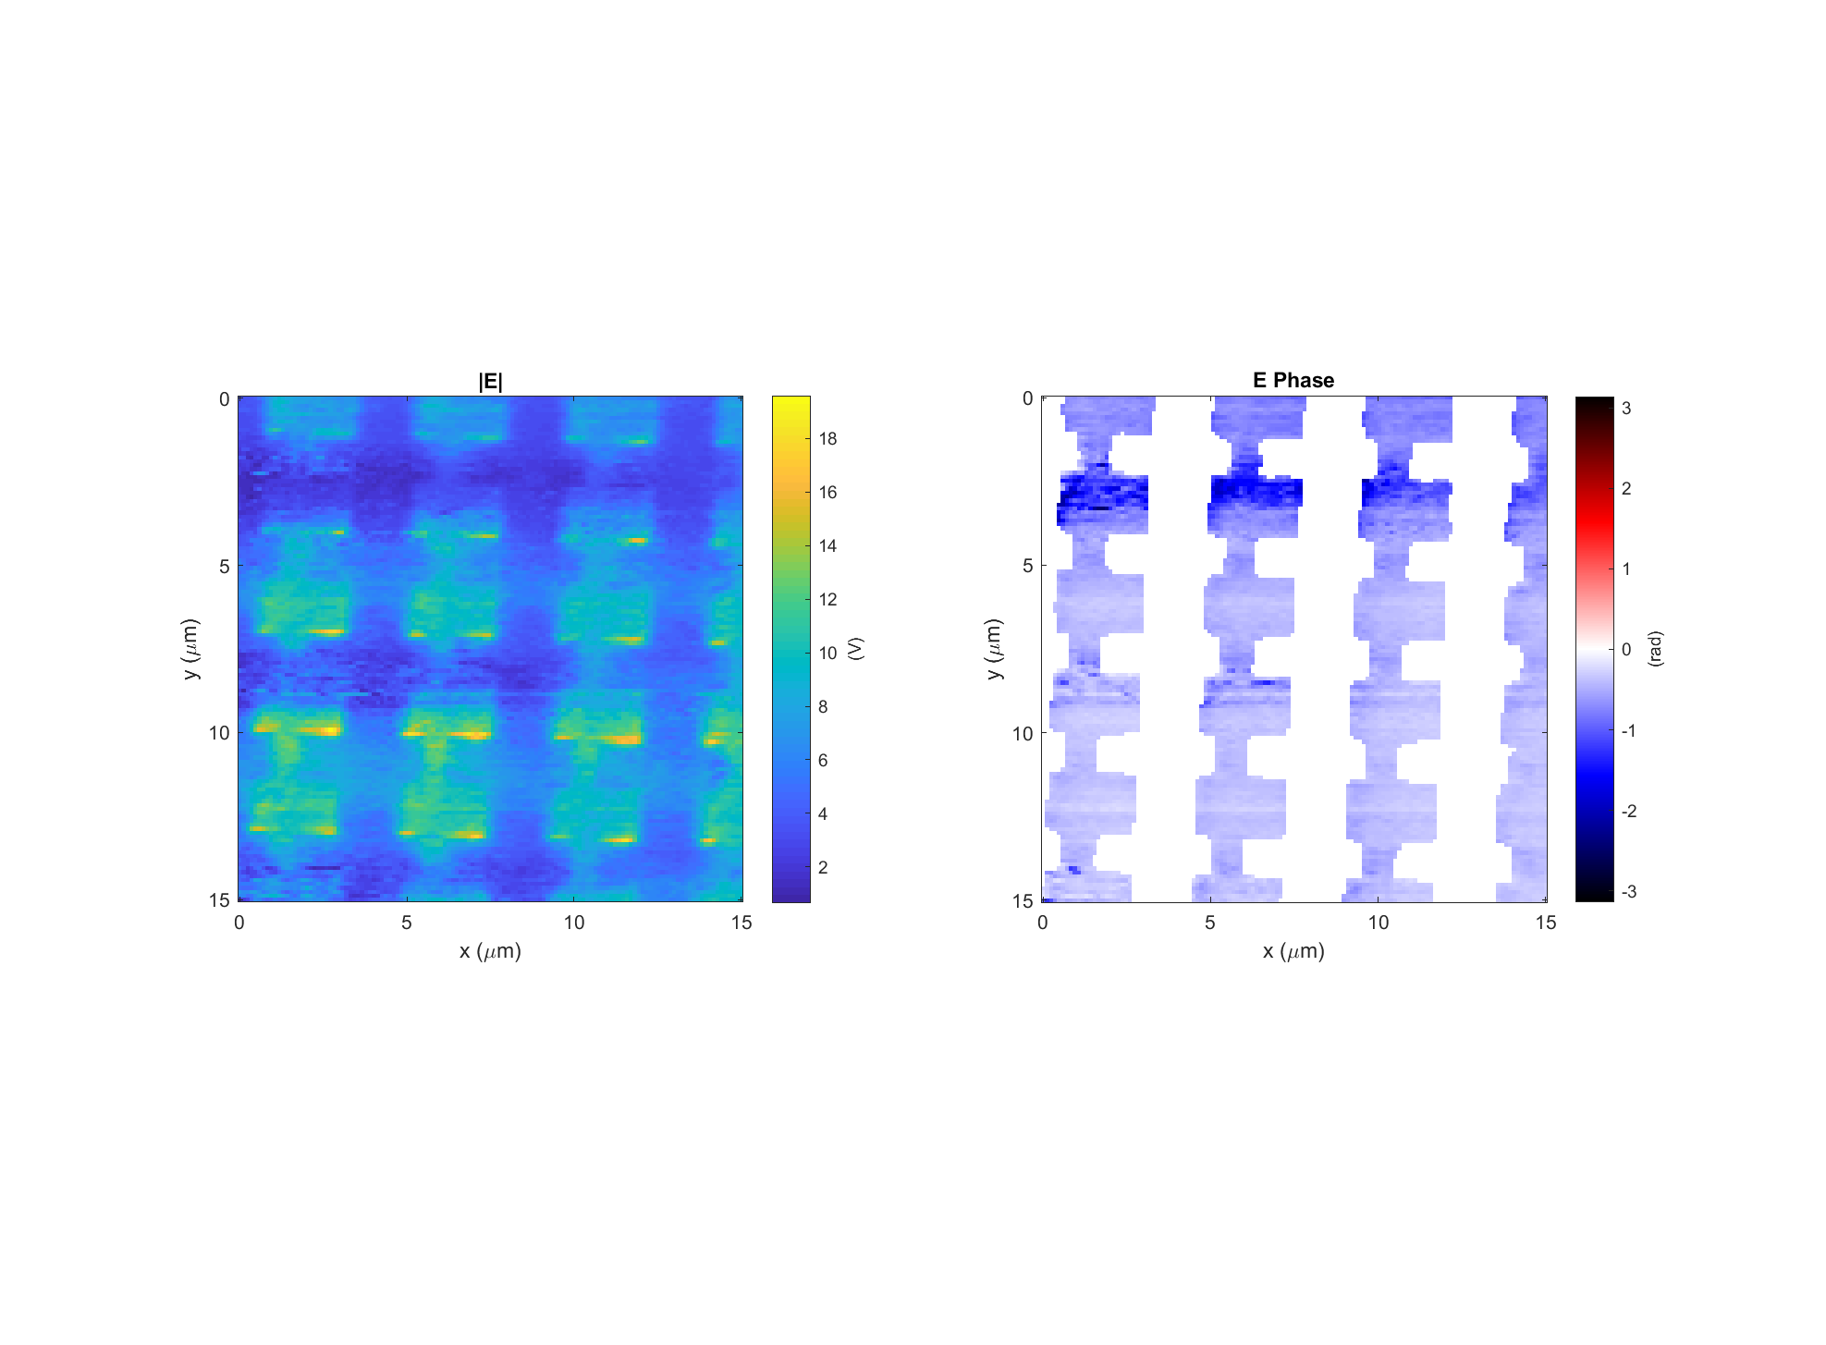
Leaky wave antenna, design #4 (E4)
Data: 2018-04-07_leaky_E_4_V_PH_X_5
Light incident from below
k

Slide 5
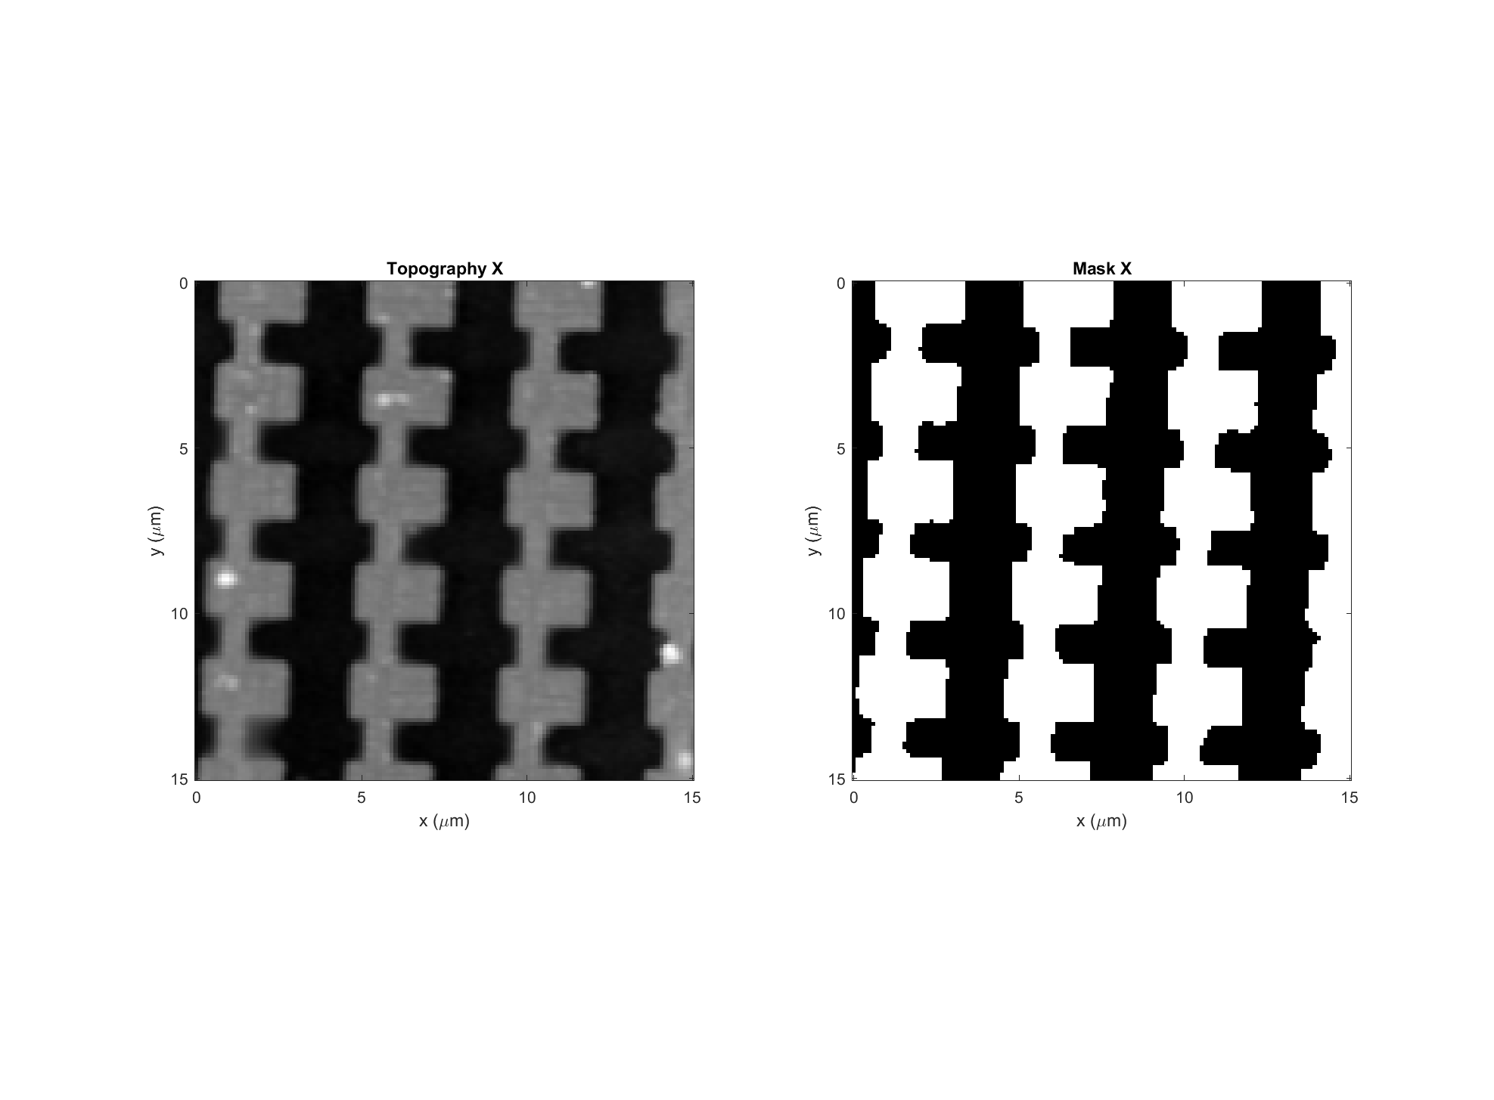
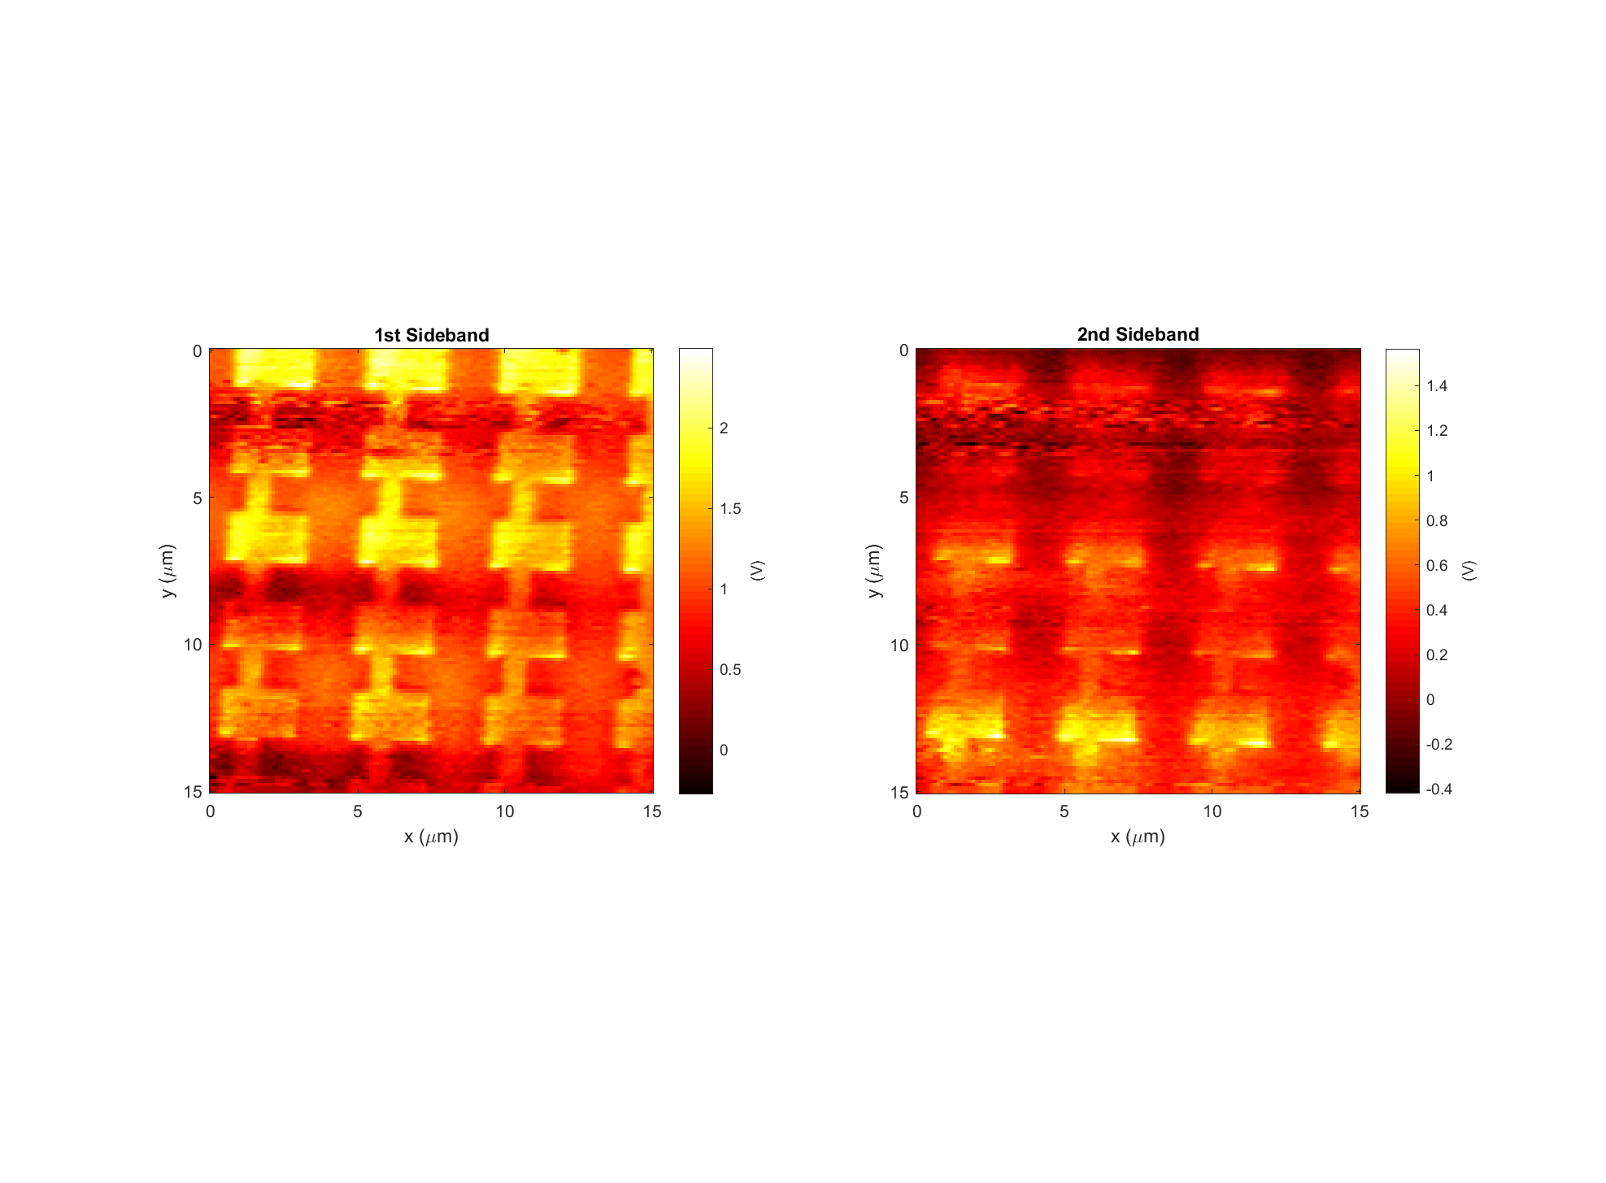
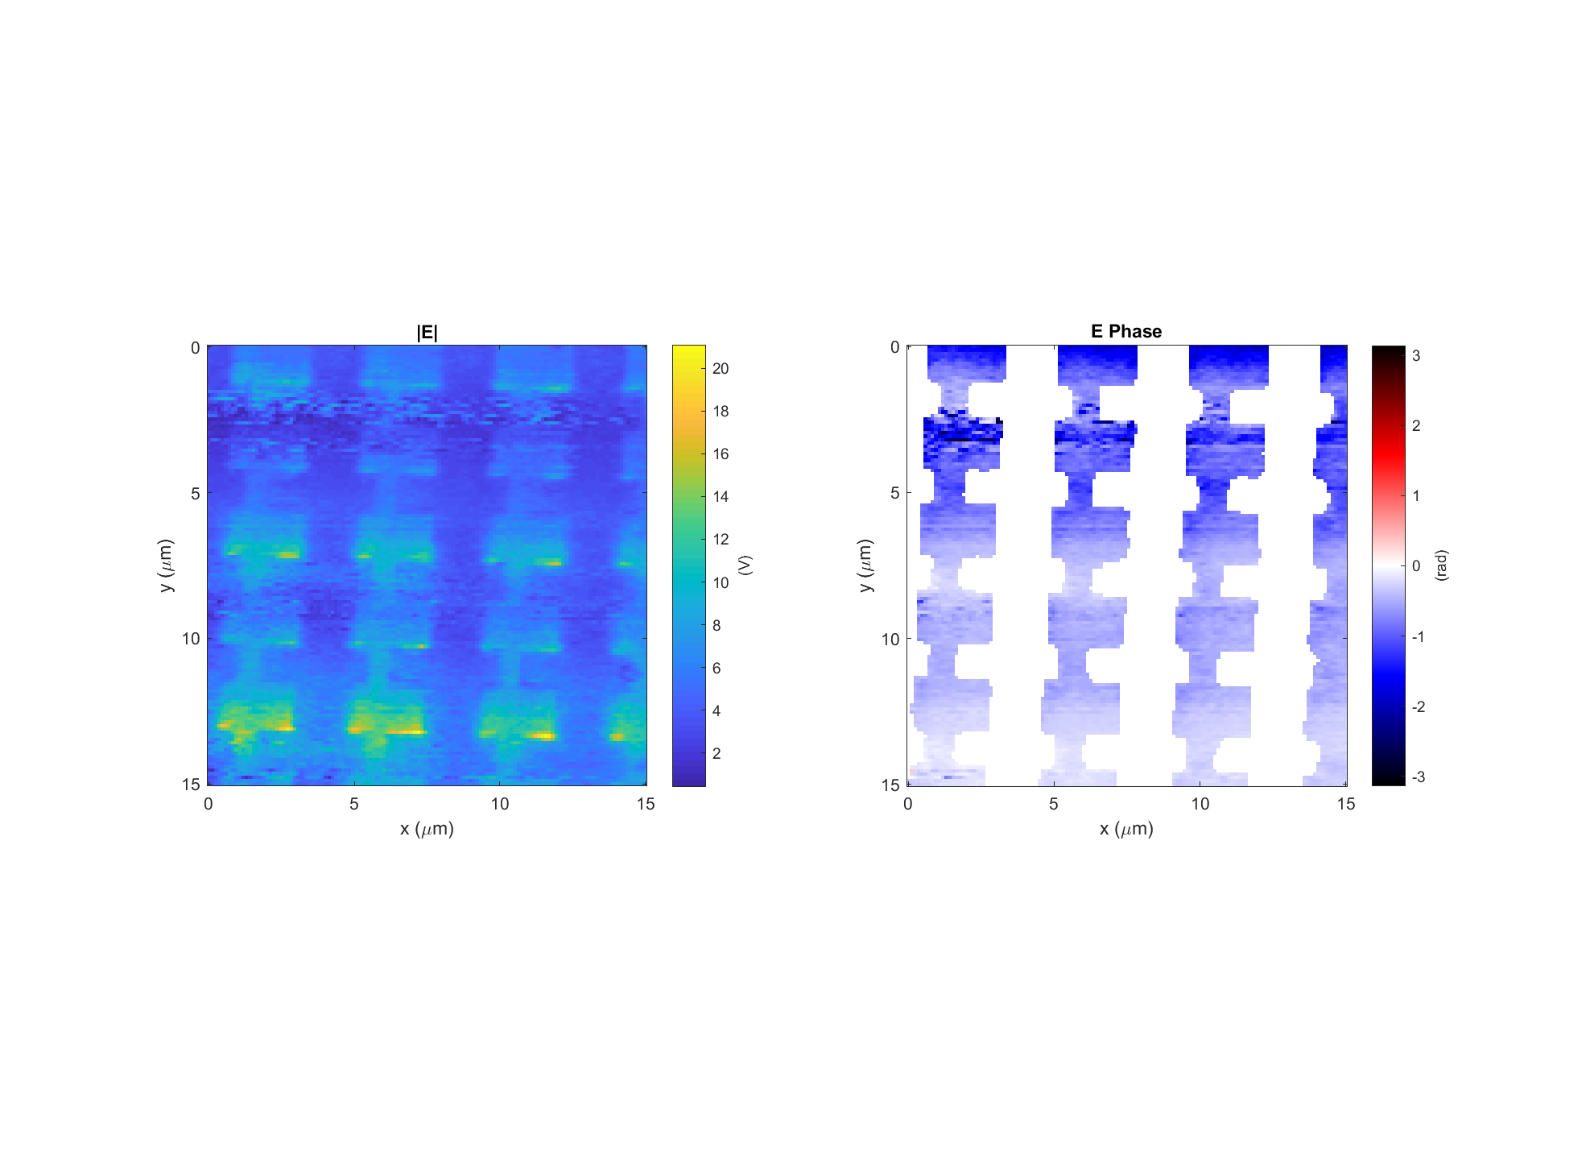
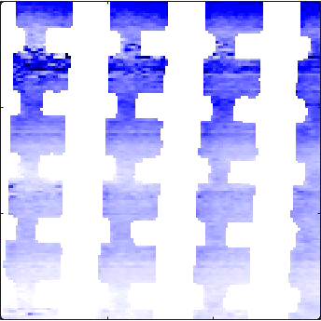
Leaky wave antenna, design #4 (E4)
Data: 2018-04-07_leaky_E_4_V_PH_X_6
Light incident from below
k

Slide 6
Illumination conditions
Incident angle θ = 60º
Light: Right hand circular pol.
Incidence: k vector is in the YZ plane
Structure E4
Z
E_{i}
Y
θ
k-vector
X

Slide 7
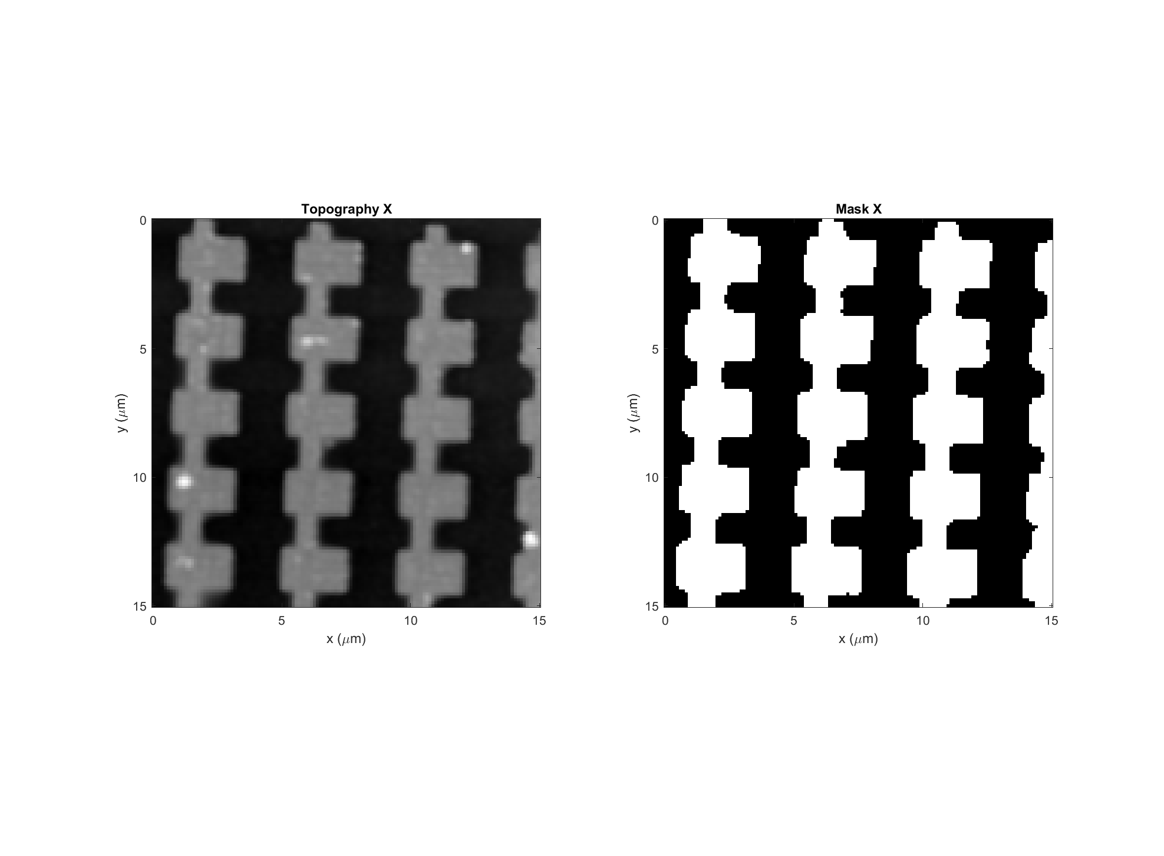
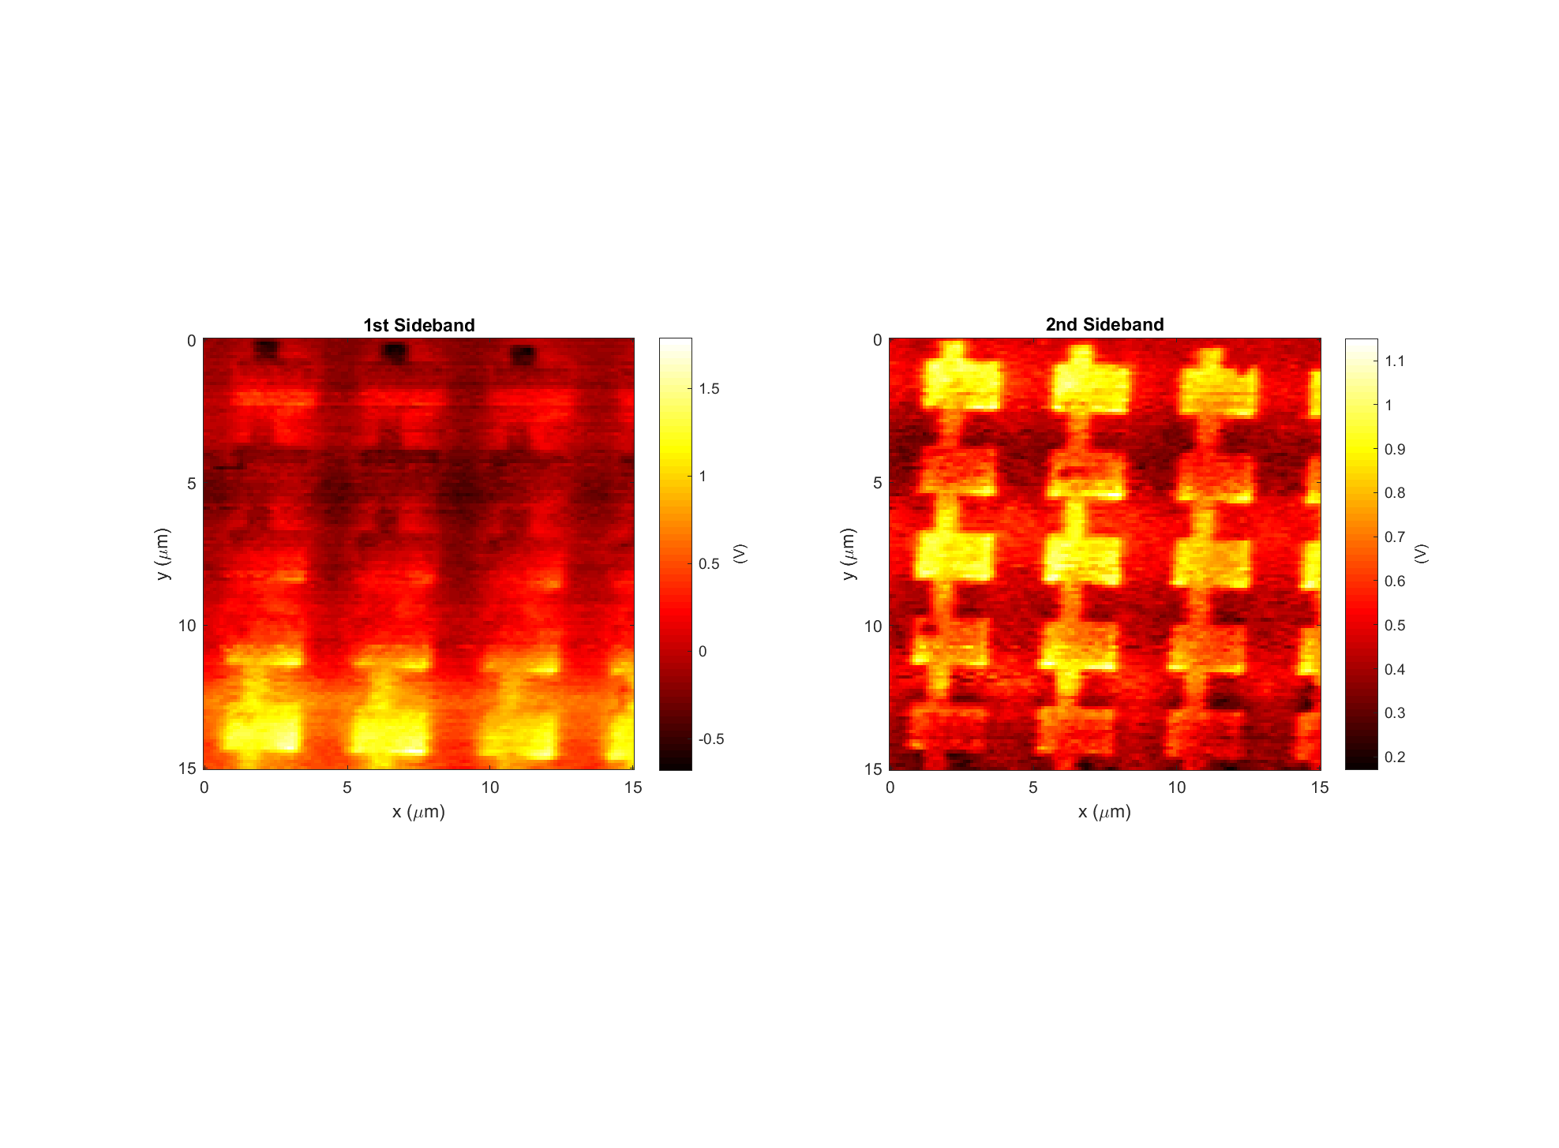

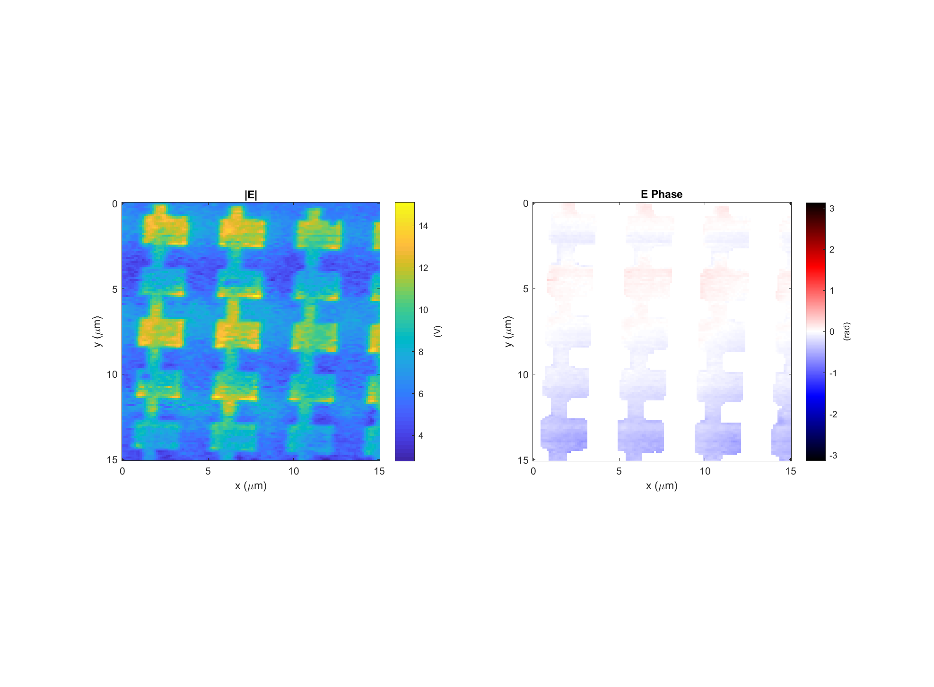
Leaky wave antenna, design #4 (E4)
Data: 2018-04-07_leaky_E_4_RHCP_PH_X_3
Light incident from below
k

Slide 8
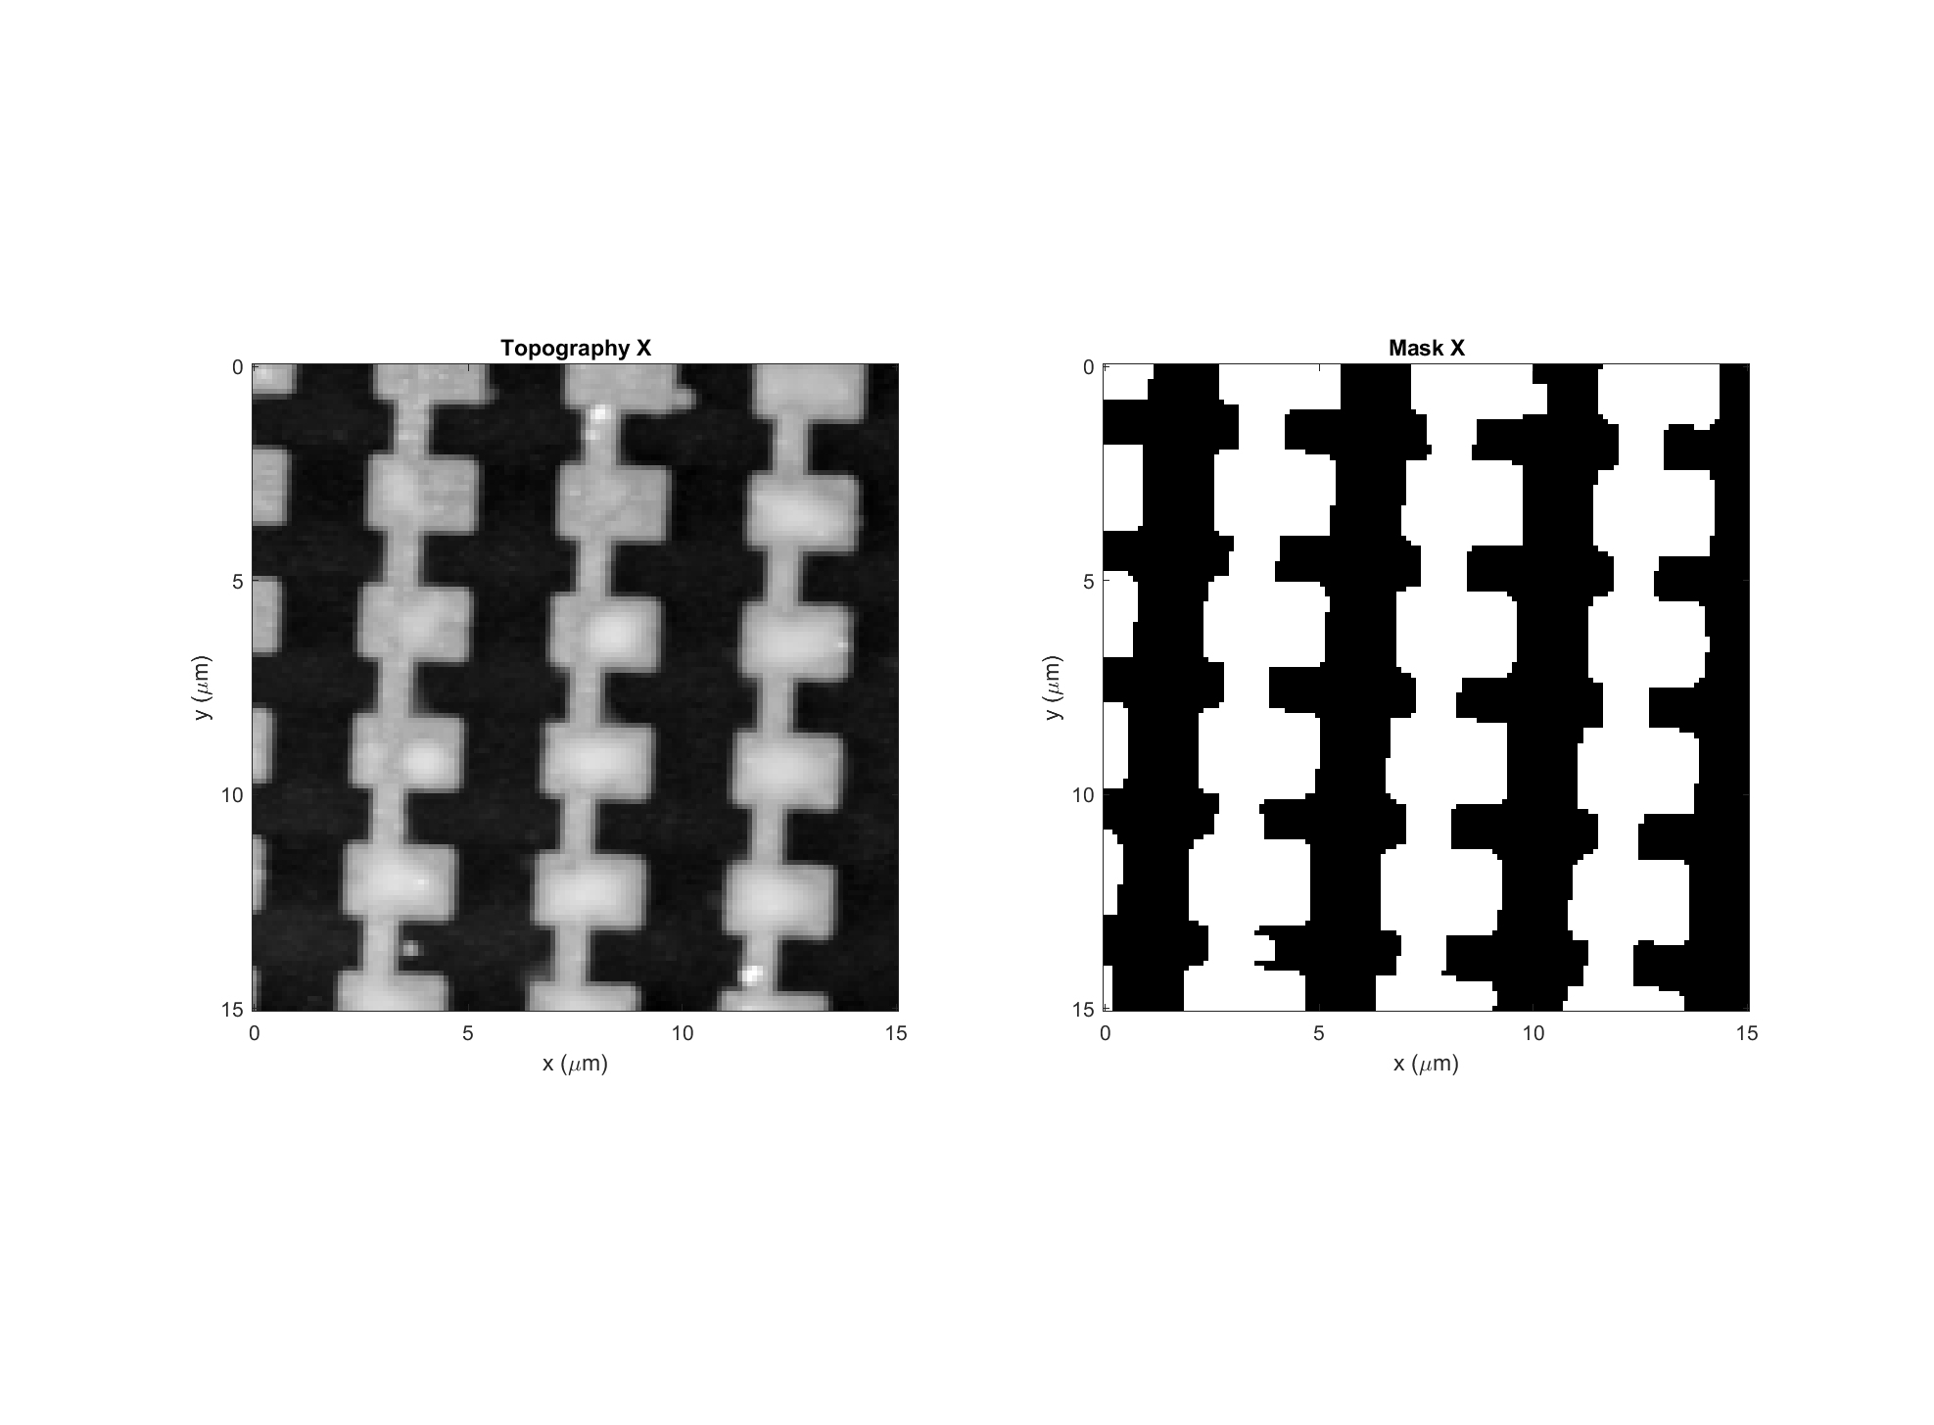
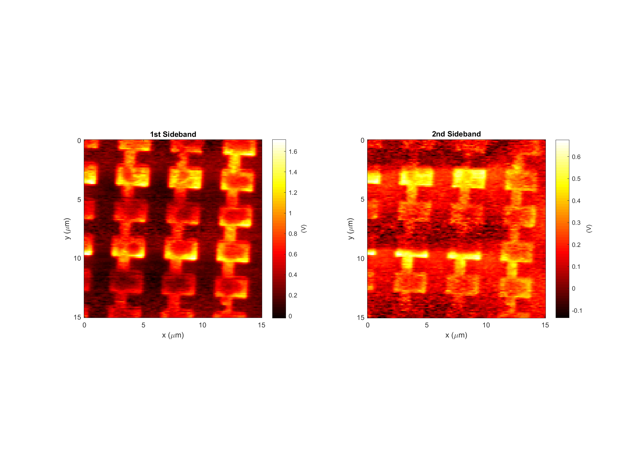
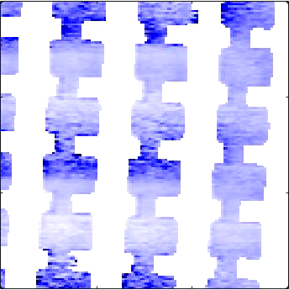
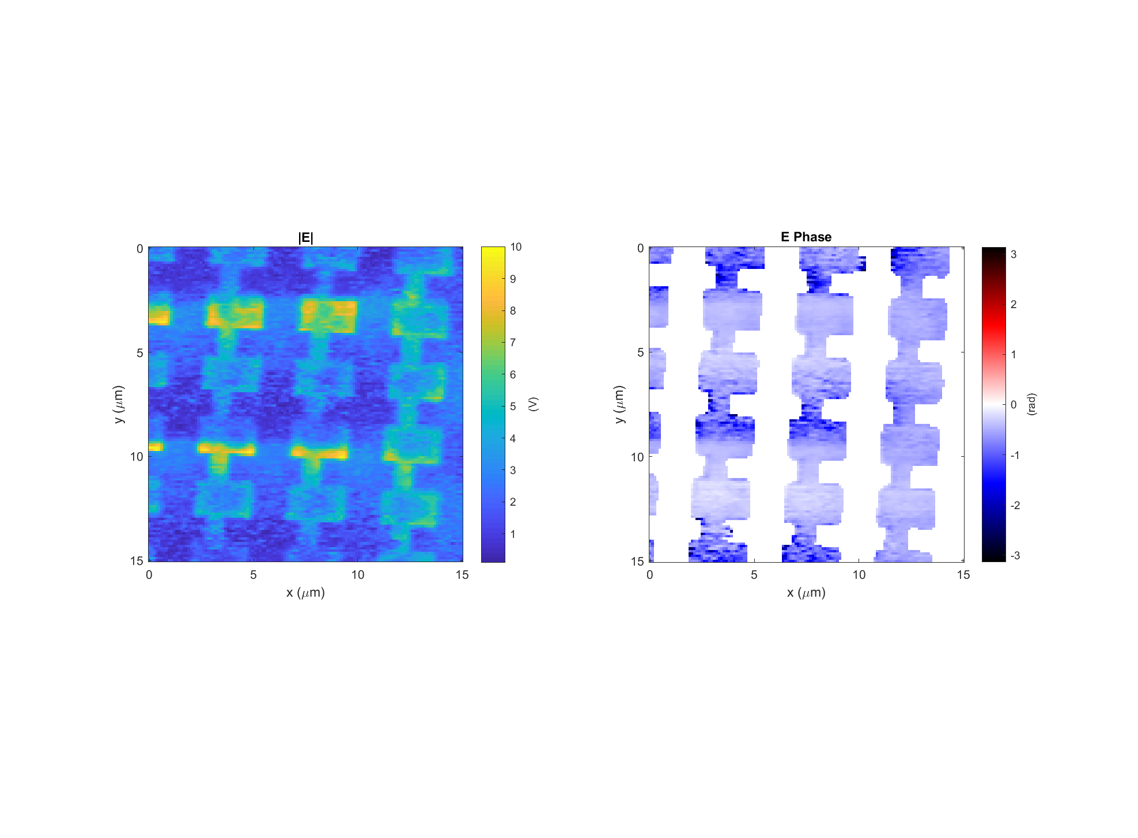
Leaky wave antenna, design #4 (E4)
Data: 2018-04-17_leaky_E4_RHCP_PH_X_1
Light incident from below
k

Slide 9

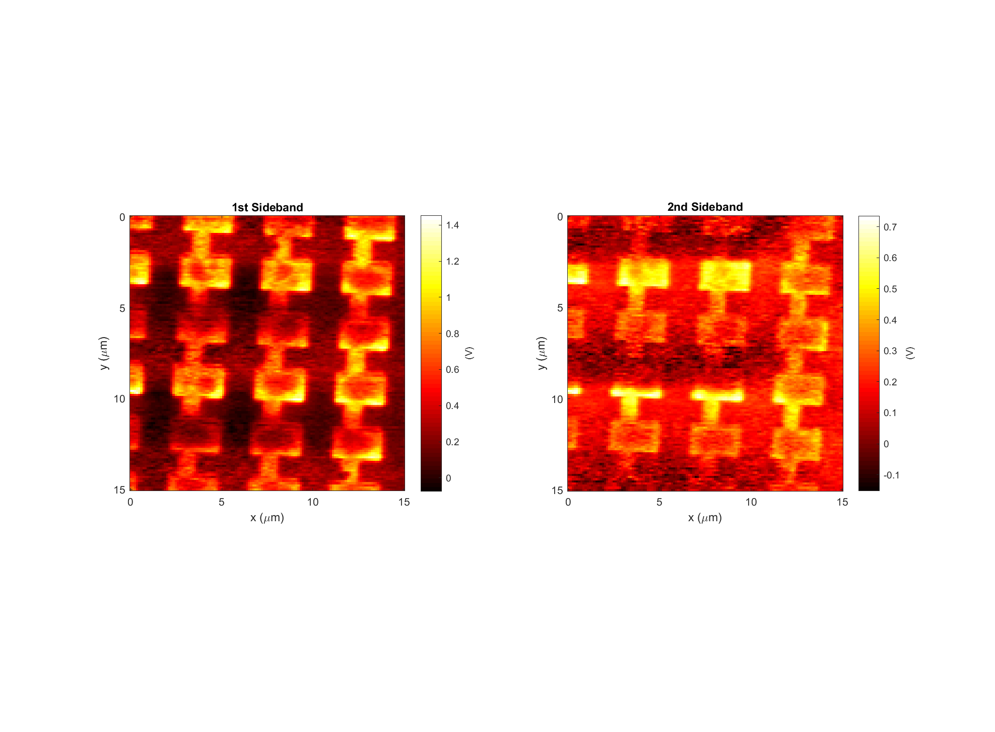
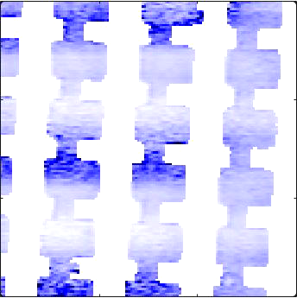
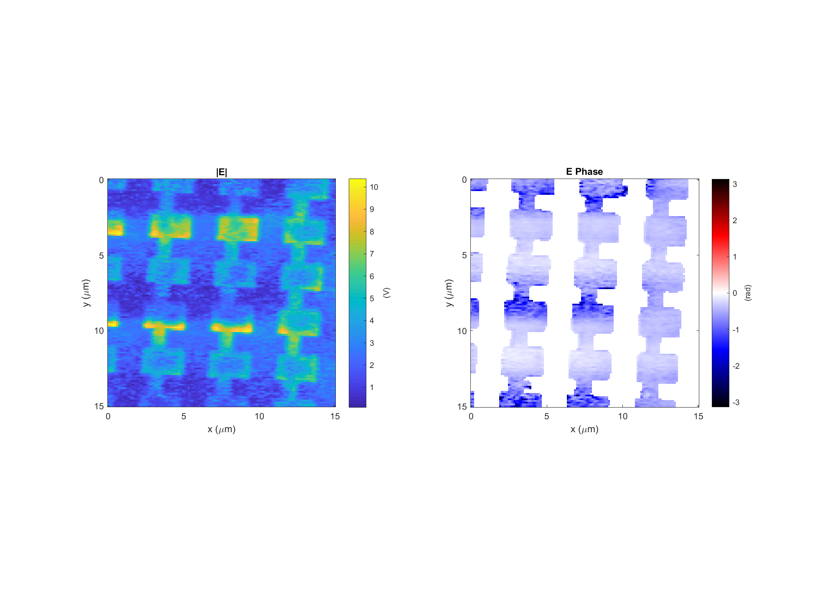
Leaky wave antenna, design #4 (E4)
Data: 2018-04-17_leaky_E4_RHCP_PH_X_2
Light incident from below
k

Slide 10

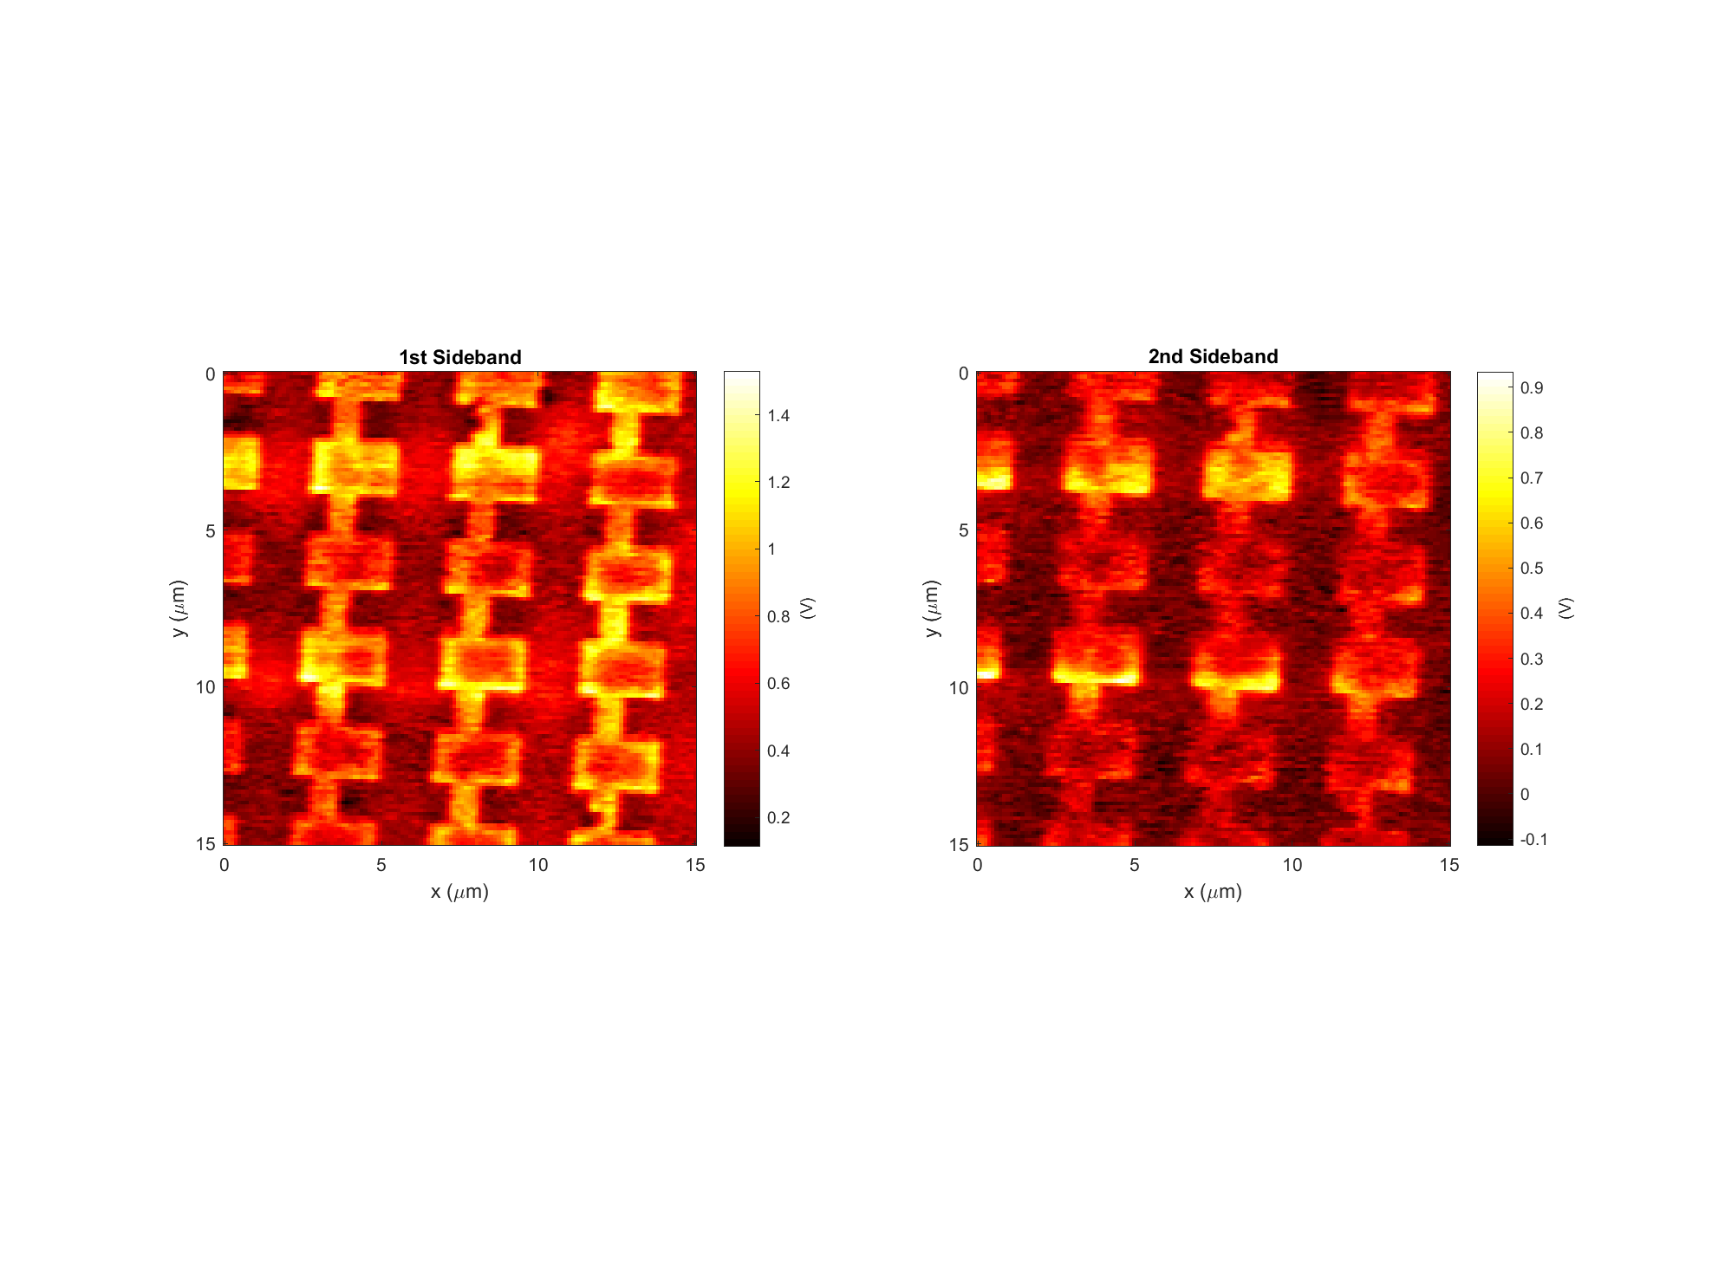
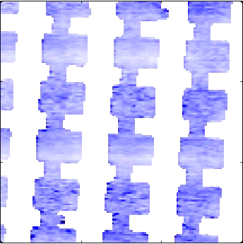
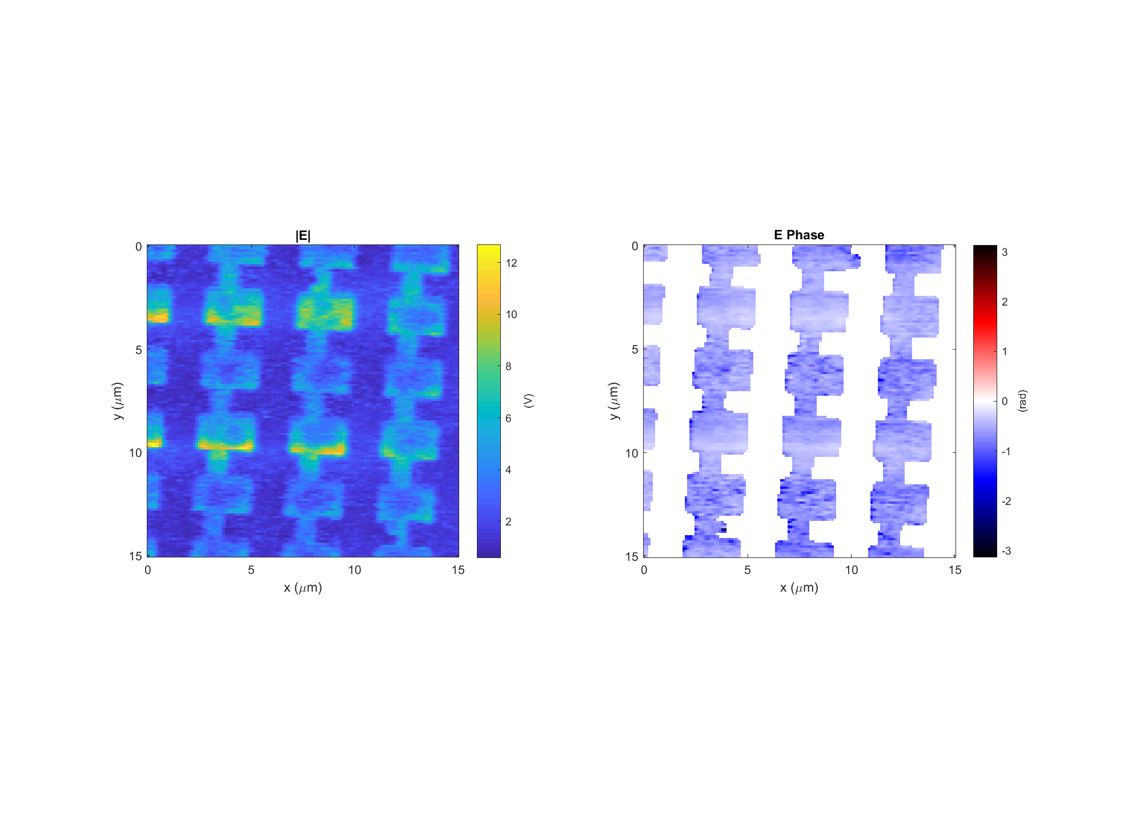
Leaky wave antenna, design #4 (E4)
Data: 2018-04-17_leaky_E4_RHCP_PH_X_2
Light incident from below
k

Slide 11
Illumination conditions
Incident angle θ = 60º
Light: Left hand circular pol.
Incidence: k vector is in the YZ plane
Structure E4
Z
E_{i}
Y
θ
k-vector
X

Slide 12
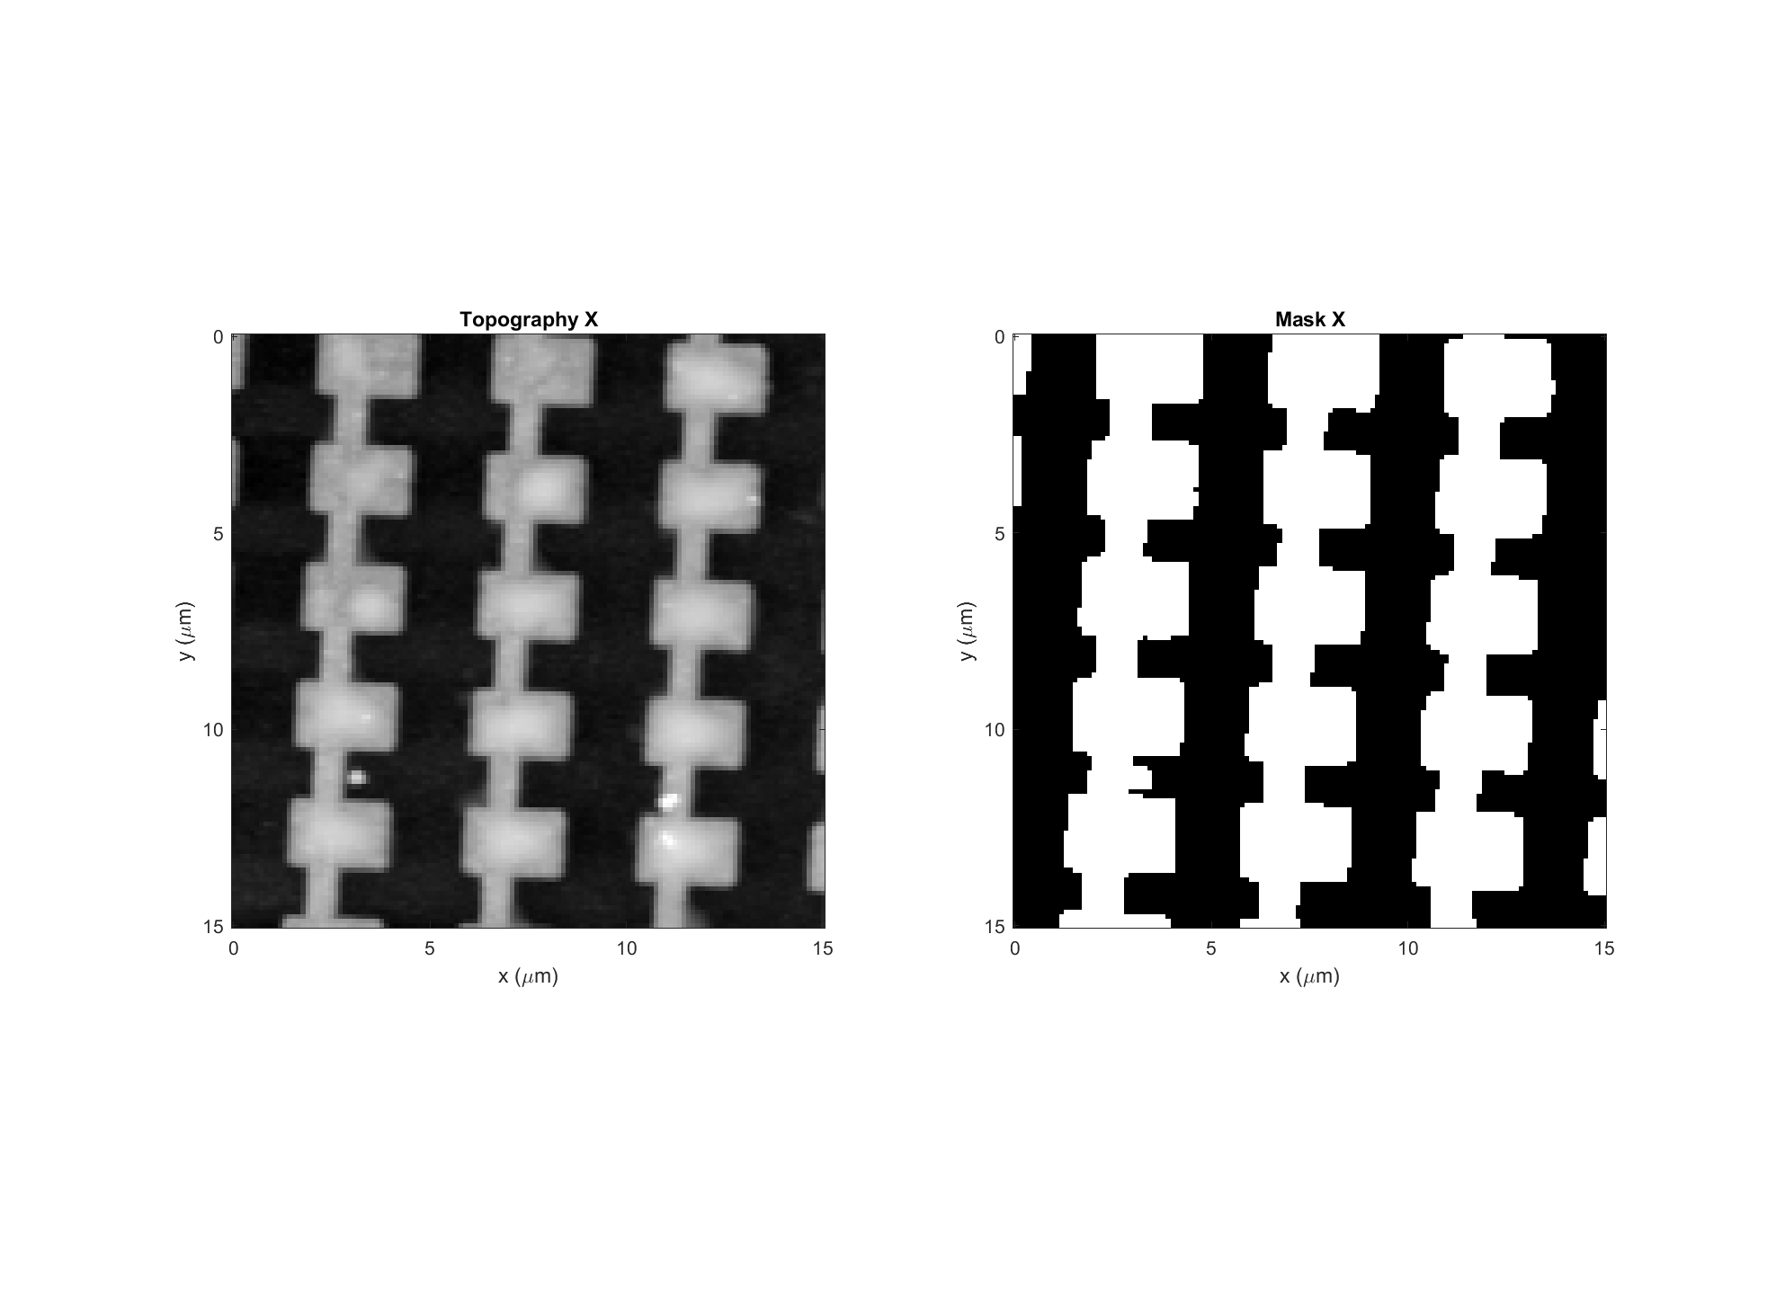
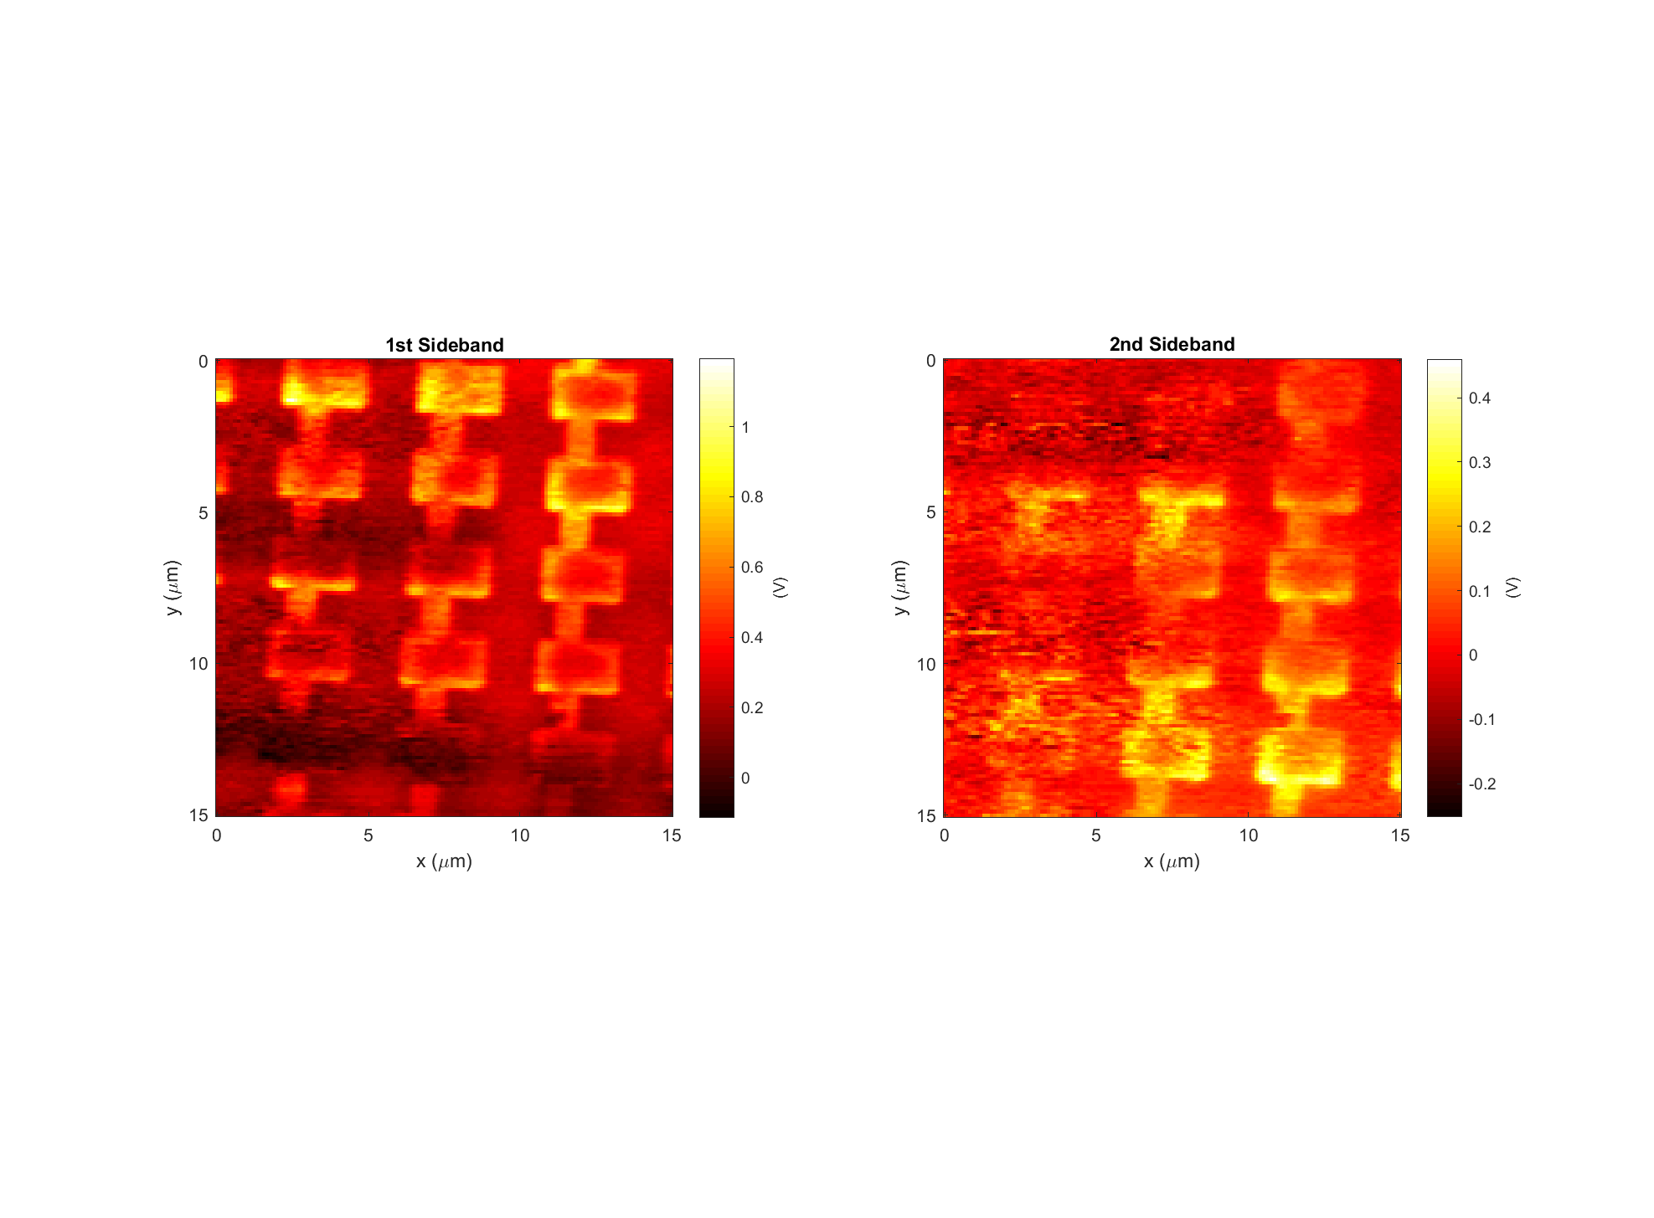
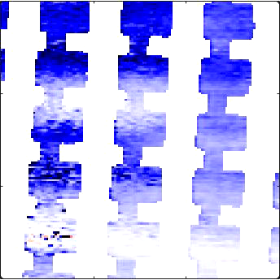
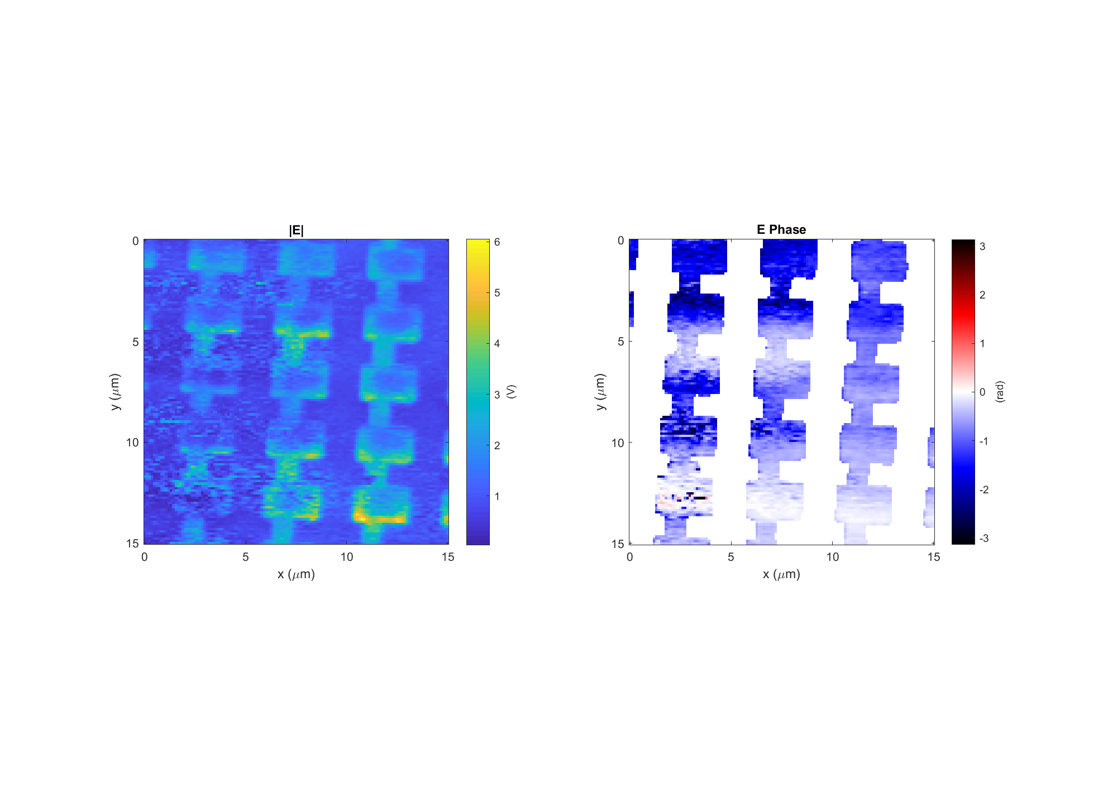
Leaky wave antenna, design #4 (E4)
Data: 2018-04-17_leaky_E4_LHCP_PH_X_1
Light incident from below
k

Slide 13
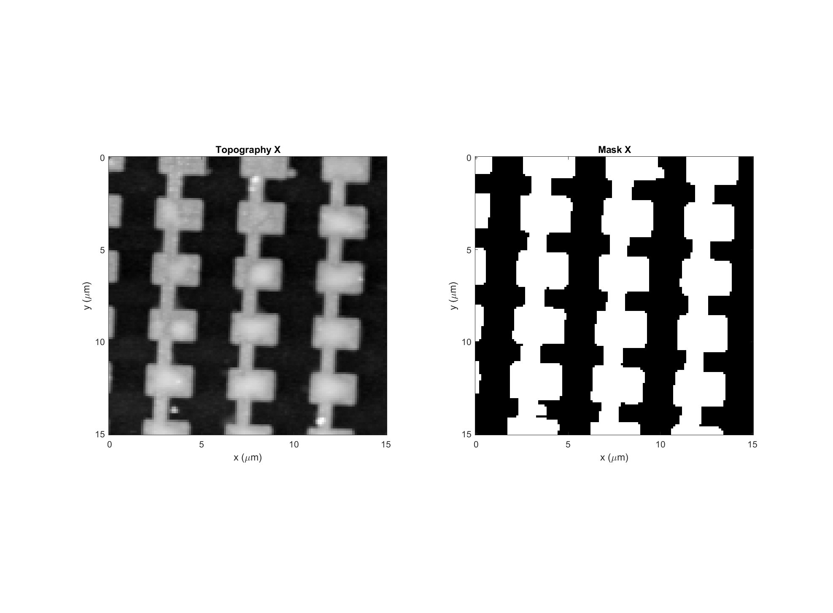
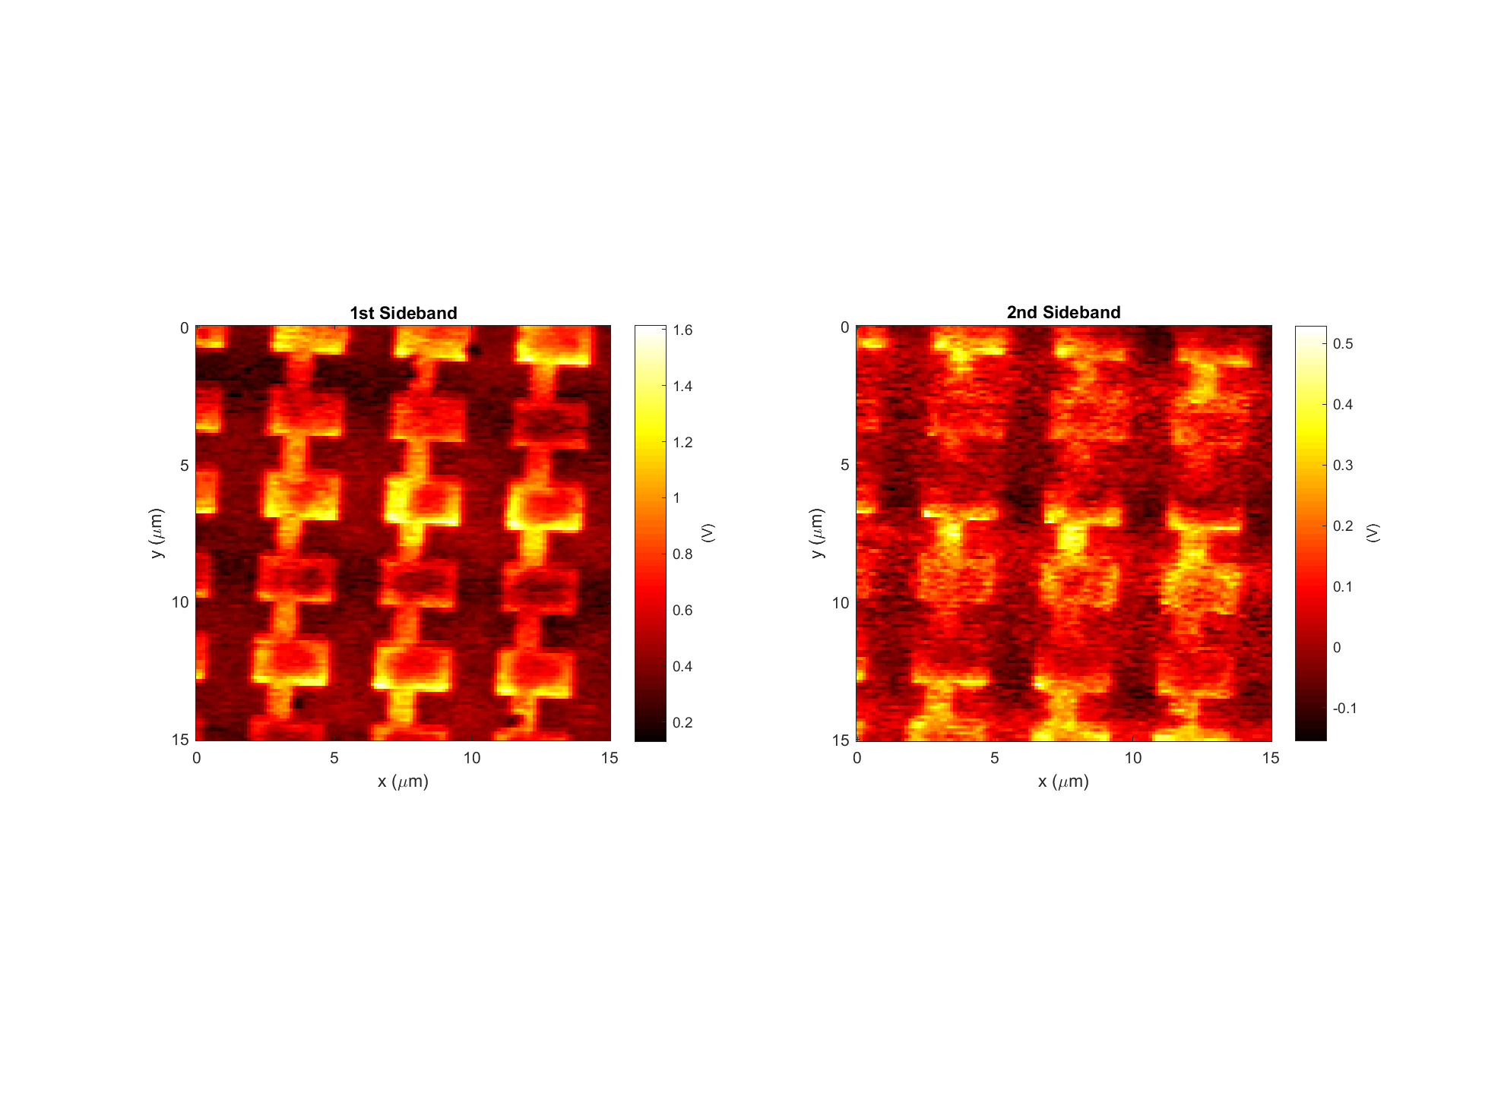
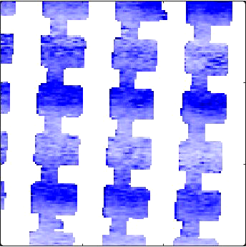
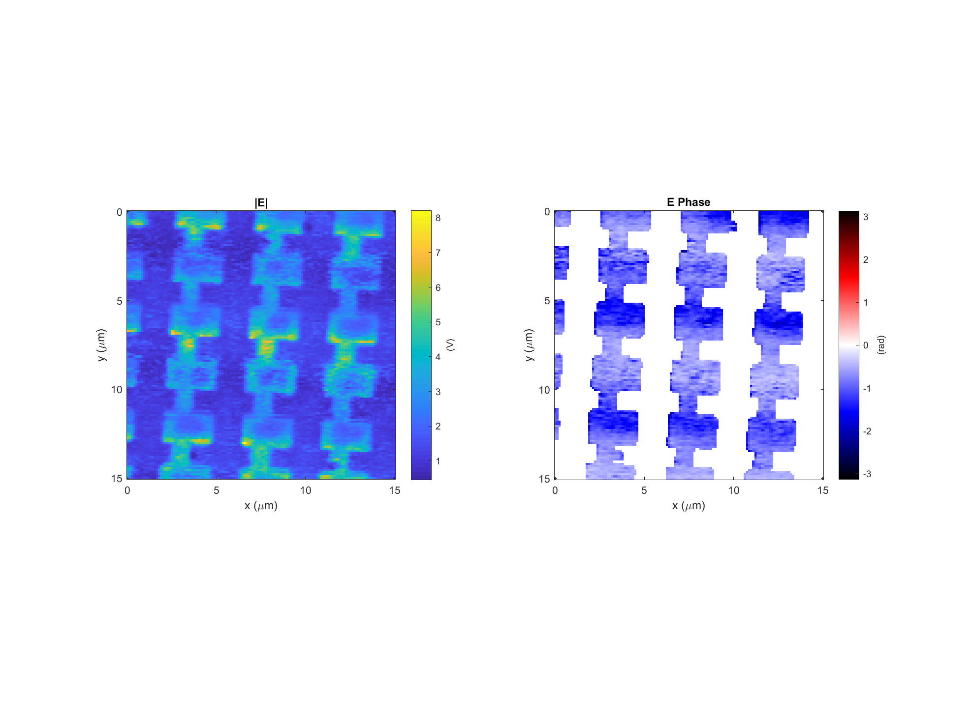
Leaky wave antenna, design #4 (E4)
Data: 2018-04-17_leaky_E4_LHCP_PH_X_5
Light incident from below
k

Slide 14
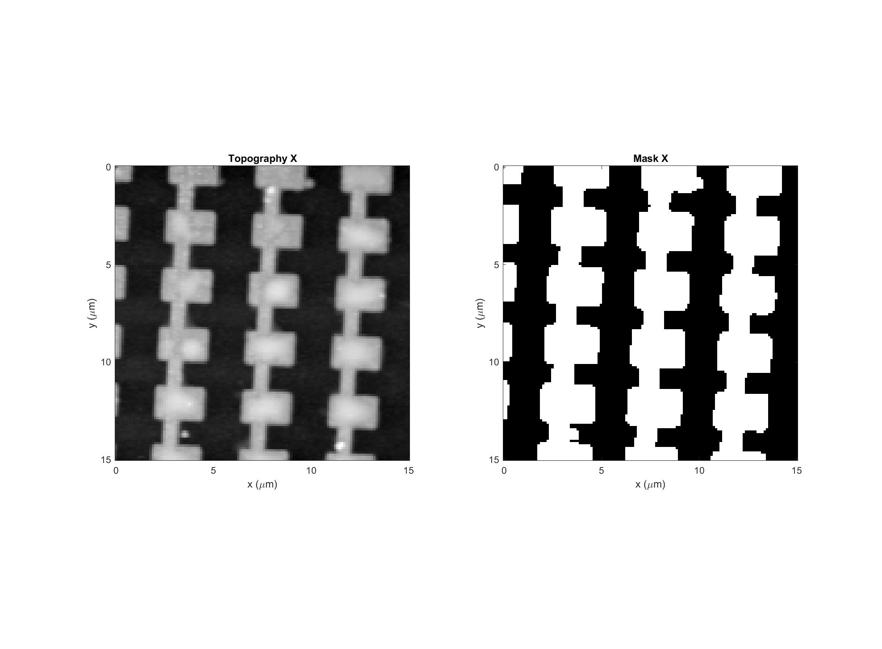
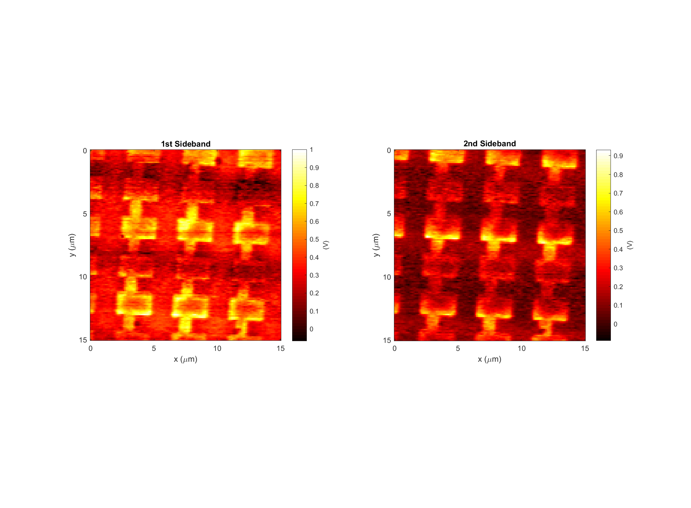
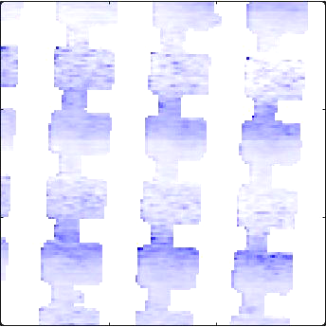
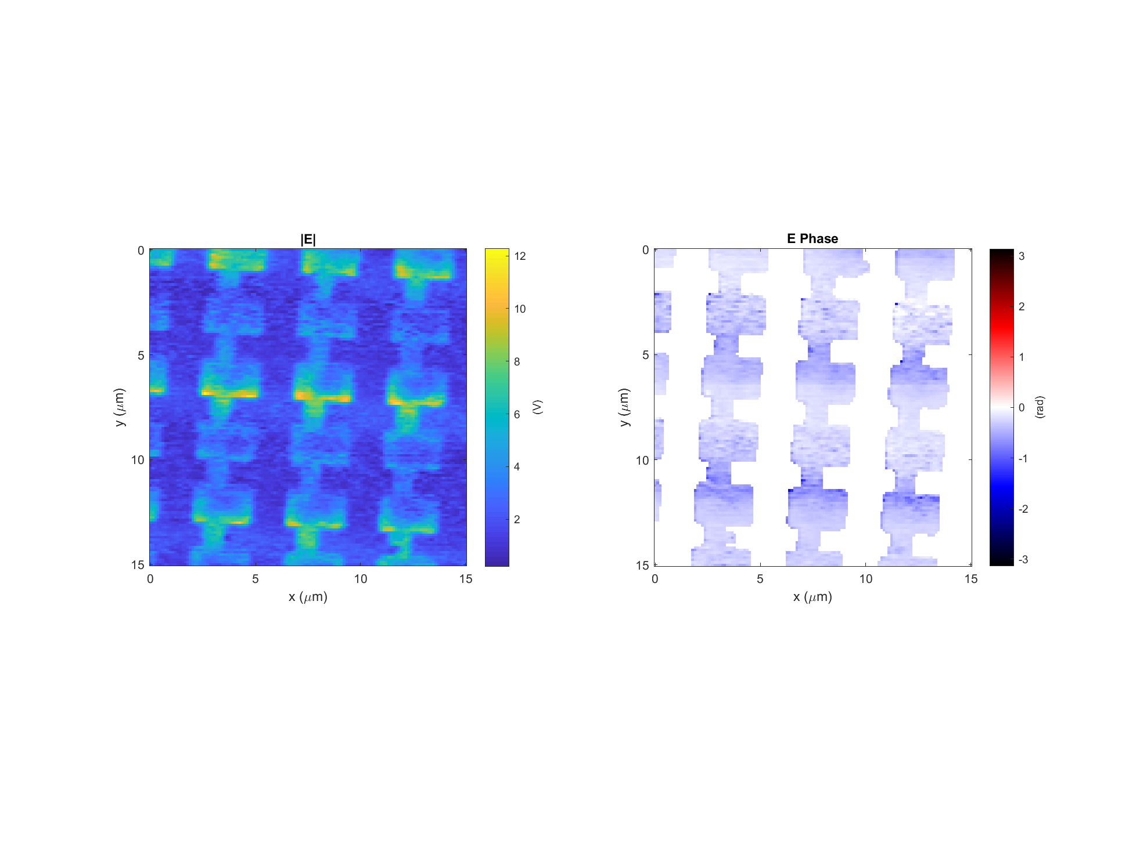
Leaky wave antenna, design #4 (E4)
Data: 2018-04-17_leaky_E4_LHCP_PH_X_7
Light incident from below
k

Slide 15
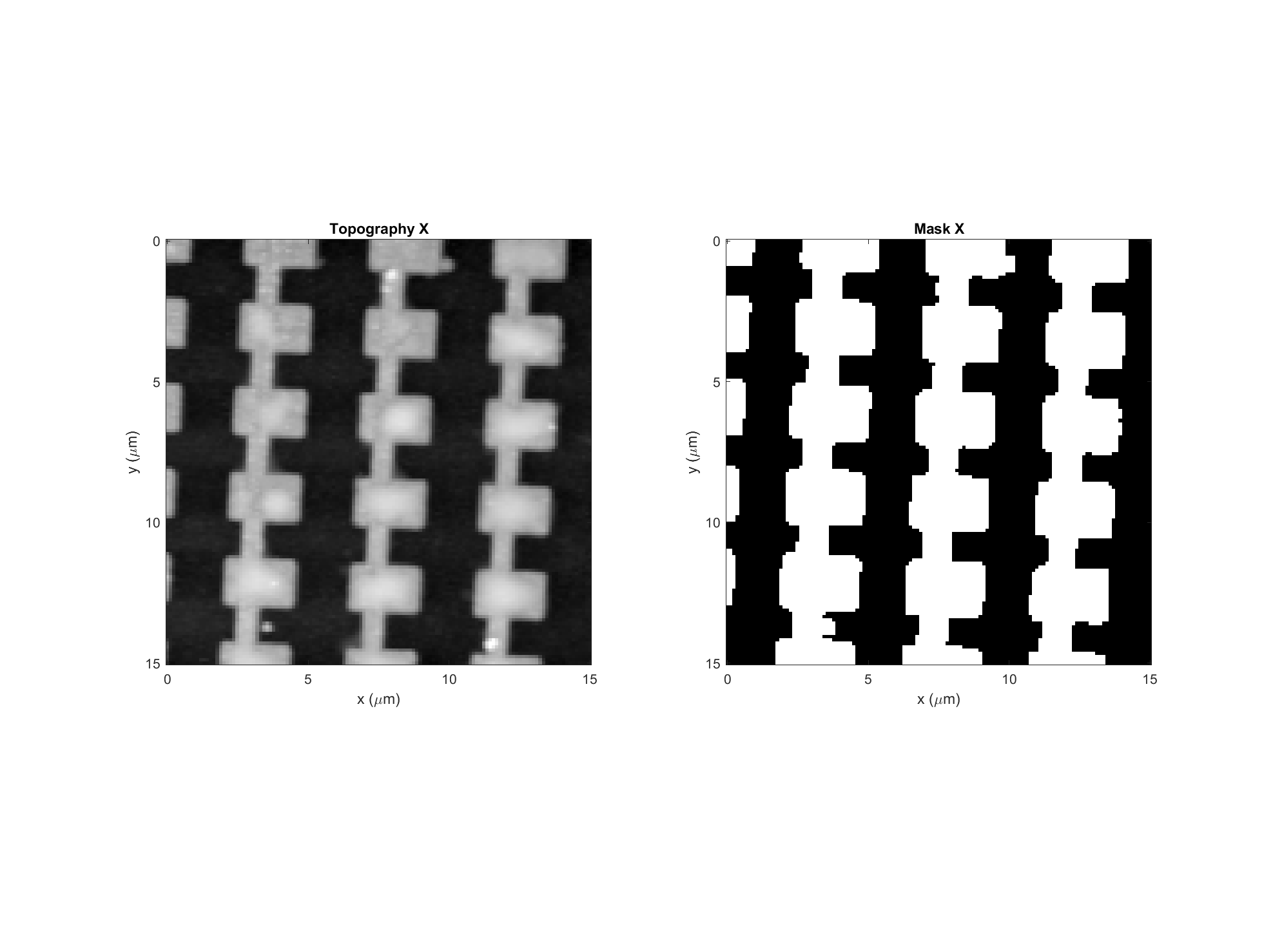
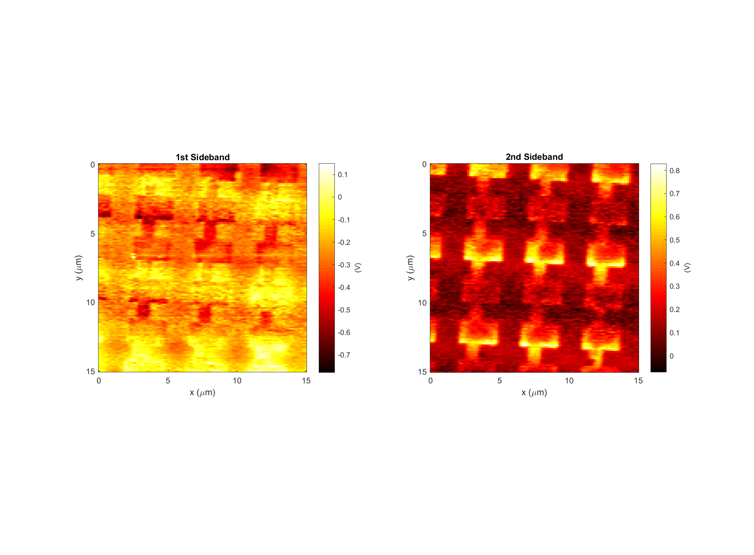
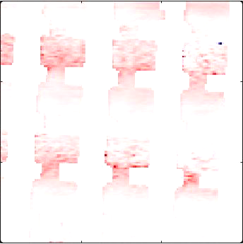
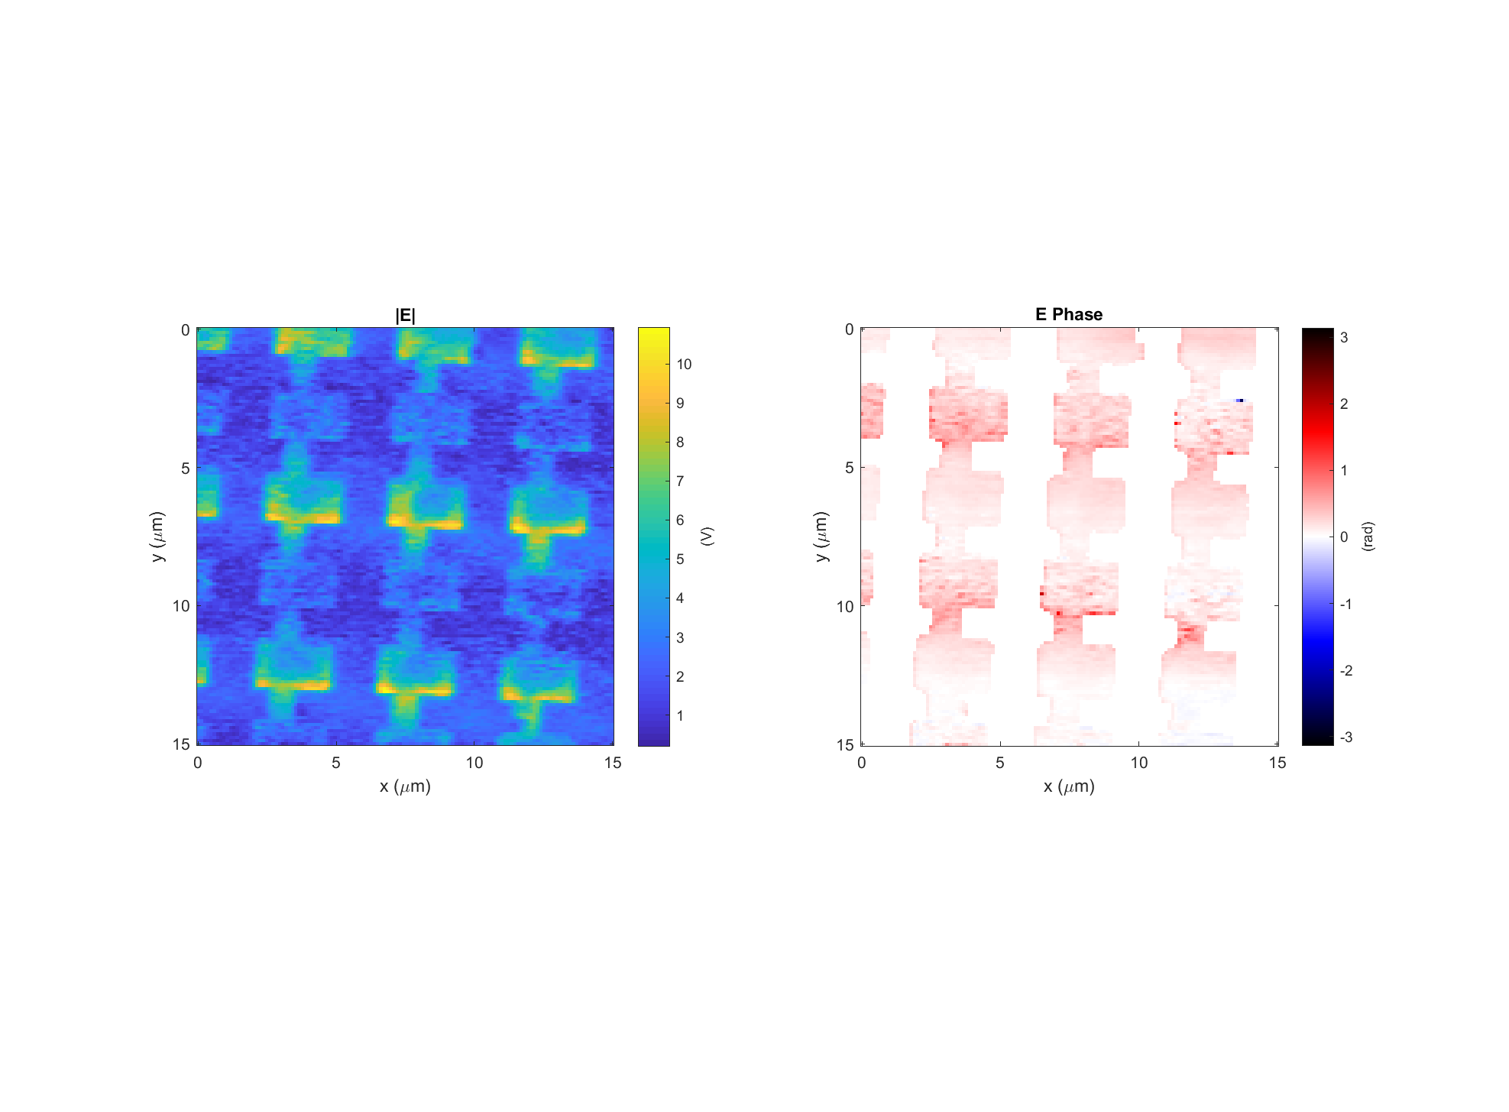
Leaky wave antenna, design #4 (E4)
Data: 2018-04-17_leaky_E4_LHCP_PH_X_8
Light incident from below
k

Slide 16

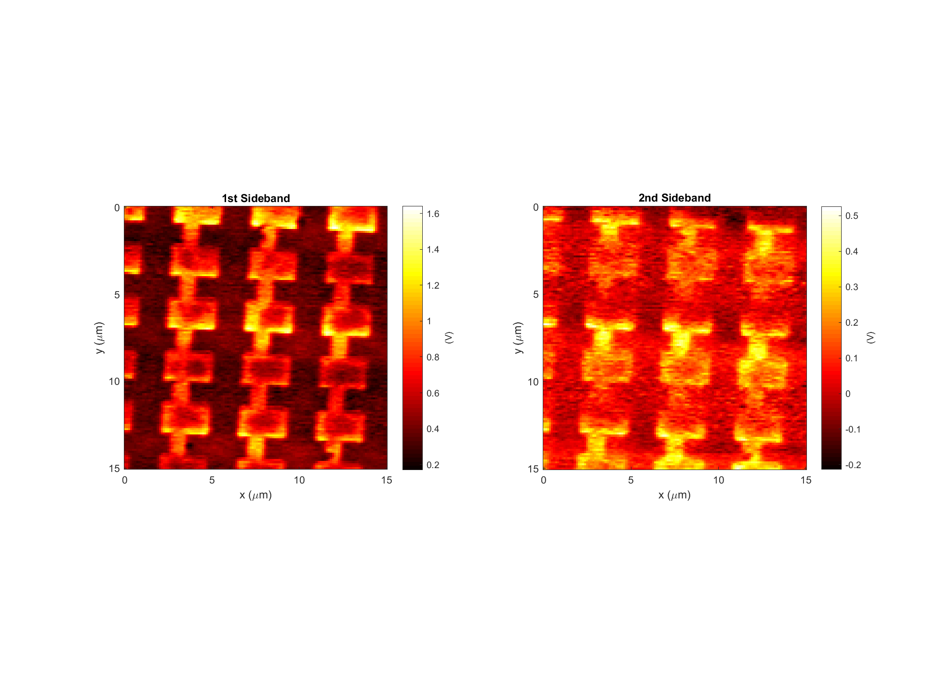
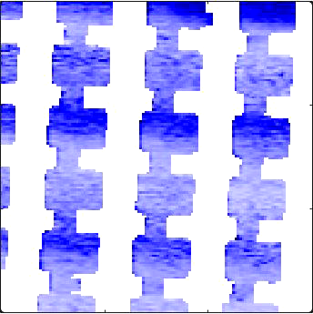
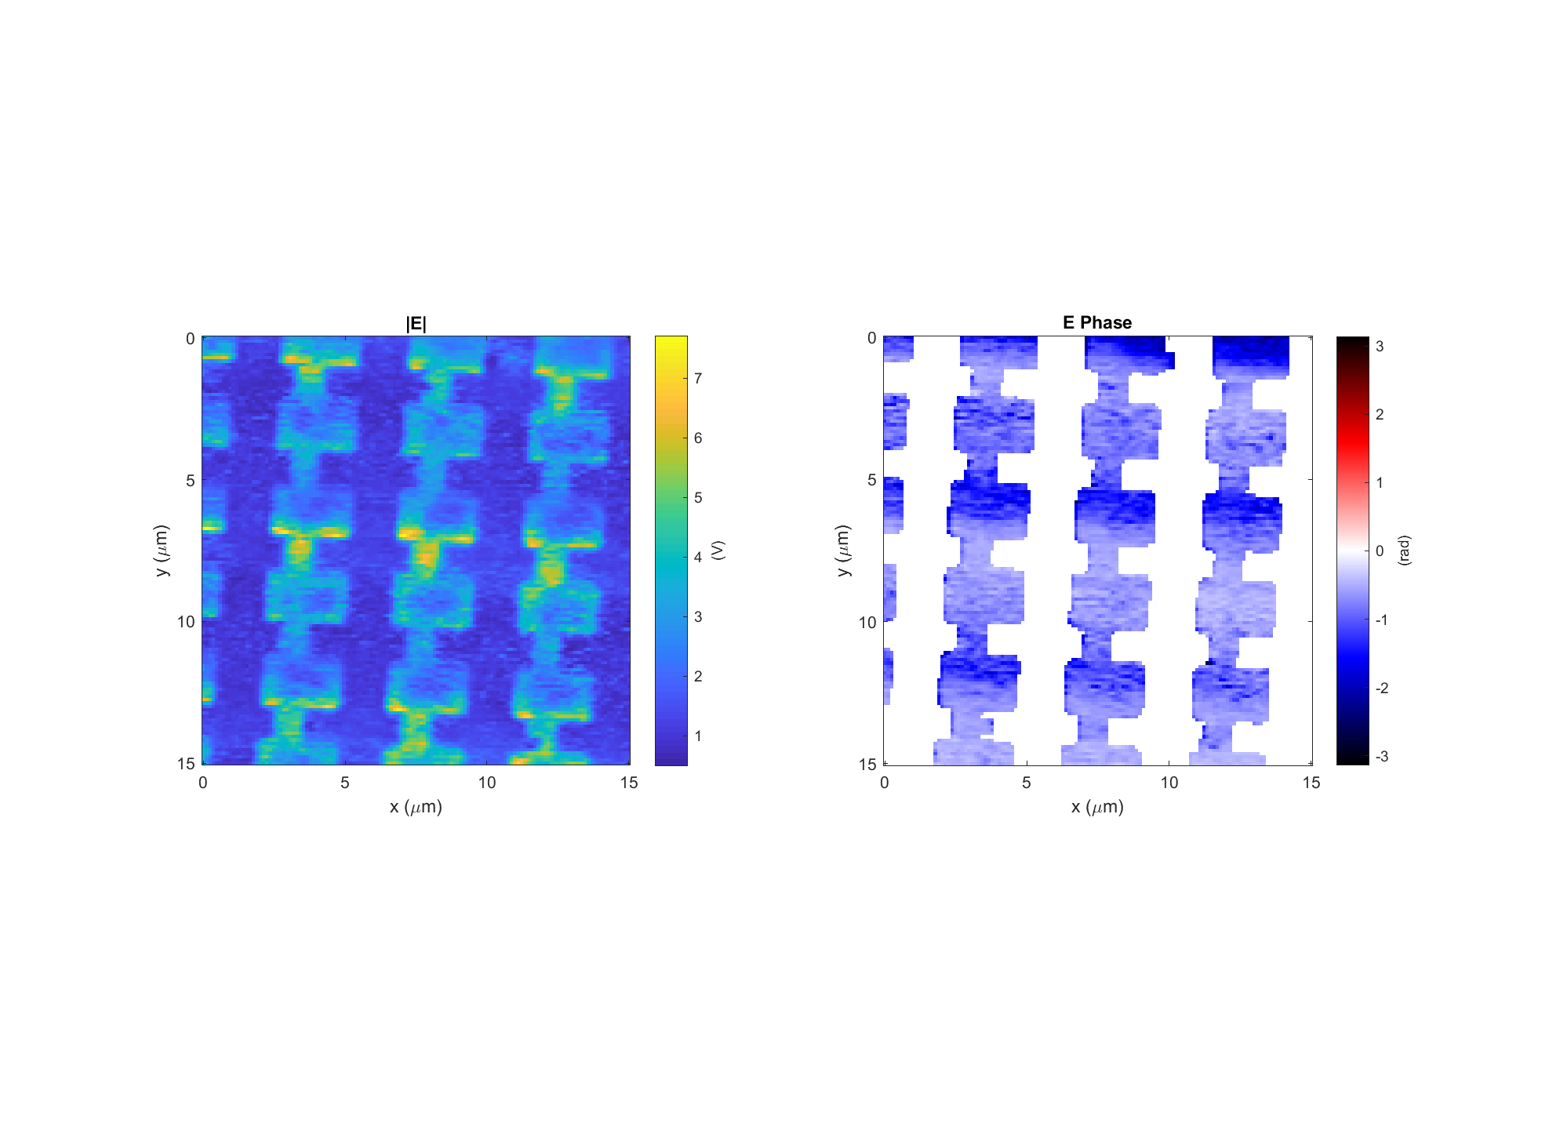
Leaky wave antenna, design #4 (E4)
Data: 2018-04-17_leaky_E4_LHCP_PH_X_9
Light incident from below
k

Slide 17

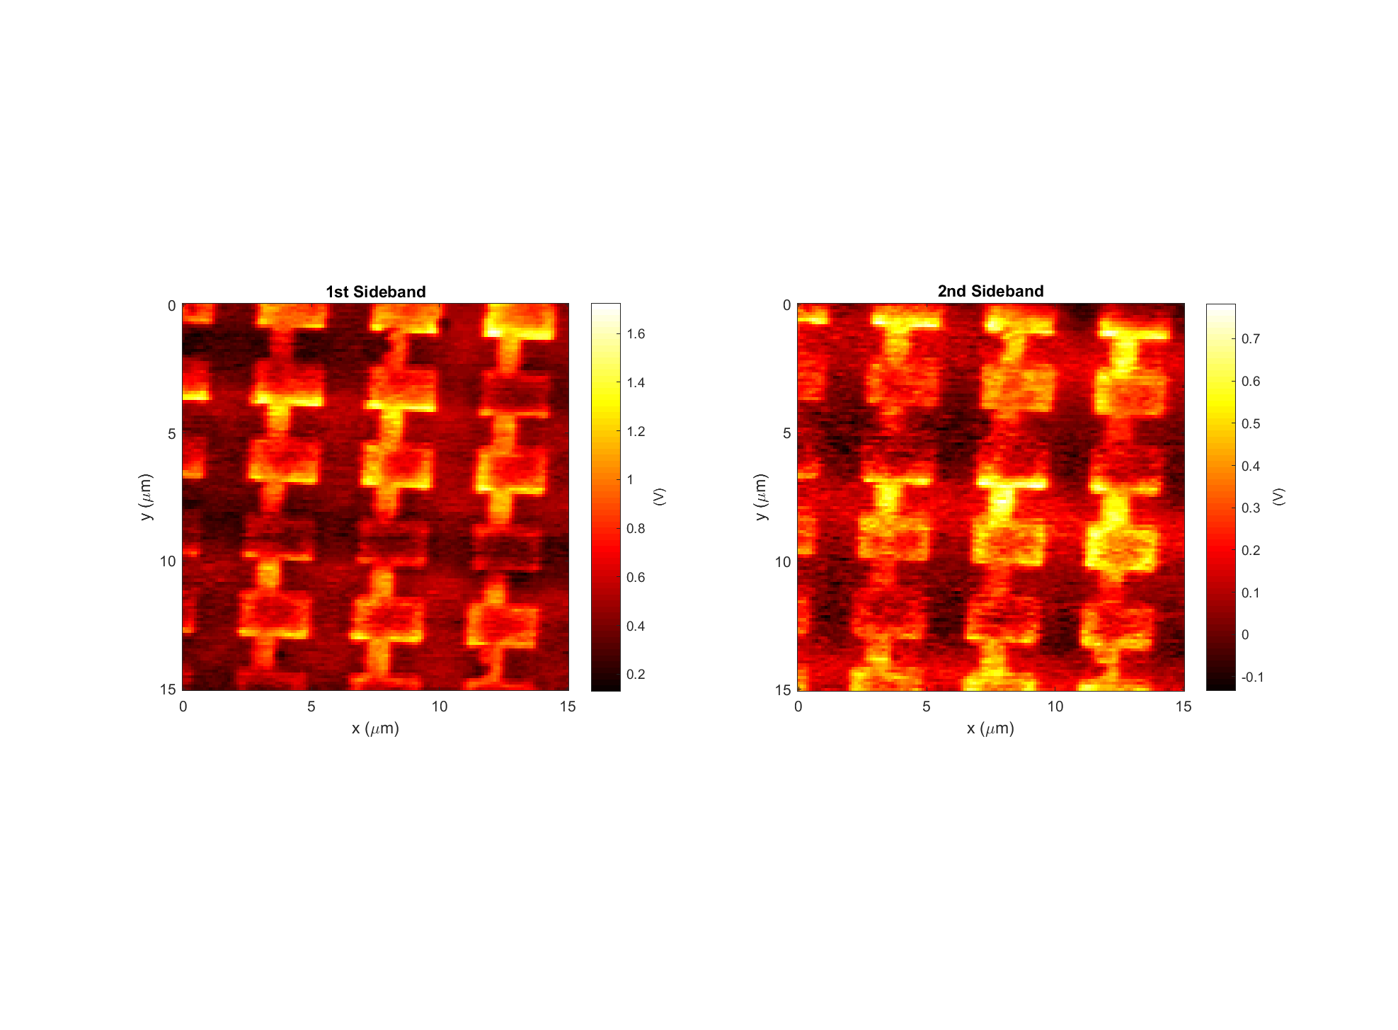
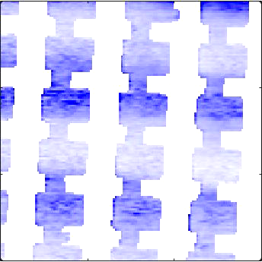
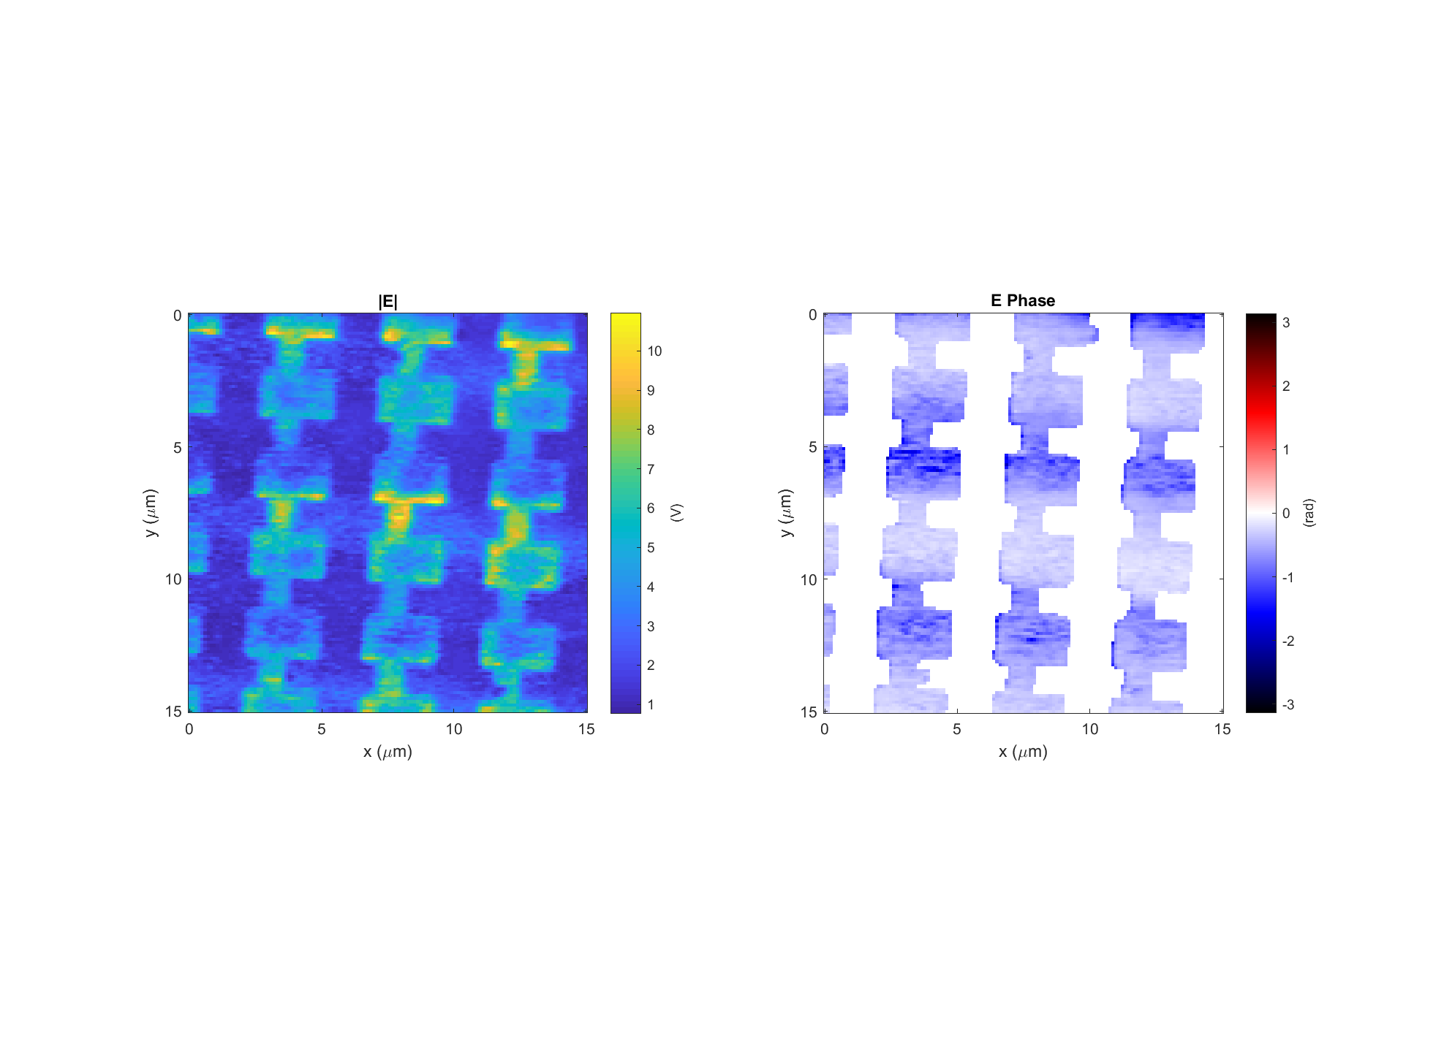
Leaky wave antenna, design #4 (E4)
Data: 2018-04-17_leaky_E4_LHCP_PH_X_11
Light incident from below
k

